Slide 1
Public Agriculture Expenditure (PAE) Analysis concepts, methods and tools, & applications
Sam Benin, IFPRI
Training for PAPA Project Collaborators
19-20 April 2016, IFPRI-Dakar, Senegal

Slide 2
Outline
Concepts (1.5-2 hours)
Rationale for public spending in the gricultural sector
Key issues and policy questions
Data needs, methods, and tools (6-7 hours)
PAE data requirements, issues, initiatives
Trends analysis—PAE performance against targets and consistency with policies and strategies
Efficiency and effectiveness of PAE
Applications (1.5-2 hours)
Costing, budgeting, prioritization

Slide 3

Key concepts (1.5-2 hours)
Good discussion of rationale in this journal article:
Mogues, Fan and Benin, (2015) 27, 337–352

Slide 4
Statement of PE allocation
Gov’t of Uganda, Poverty Eradication Action Plan, 2004
The demands for PE always outstrip the resources … available to fund them. ... If PE is to maximize its contribution to the PEAP, … three conditions …[be] met:
Inter-sectoral budget allocations be shifted in favor of those sectors which can make the strongest contributions to … accelerating pro-poor growth, ….
Intra-sectoral budget allocations be shifted in favor of projects and programs which most clearly contribute to poverty eradication in a cost effective manner.
Efficiency is improved in all areas of PE, so that better value for money … can be achieved with the scarce resources ….

Slide 5
Why public spending in agriculture?
Rationale for PE in general derives from two main sources:
Economic inefficiencies because of market failures due to characteristics of goods and services (G&S) and market participants that create divergence between social and private net benefits (characteristics = public goods, externalities, information asymmetries, imperfect markets)
Inequality in the distribution of G&S due to how resources were initially allocated. In agriculture, G&S are typically biased against majority of people who live in rural areas and depend on agriculture for their livelihoods

Slide 6
Efficiency rationale
Public good issues
Non-rivalry (one’s consumption does not reduce amount others can consume) and non-excludability (no one can be excluded)
Those G&S underprovided by private agents (e.g. basic R&D germ plasm, markets/favorable prices at harvest)
Government can subsidize basic R&D or invest in market infrastructure
Externalities
Producer does not bear full cost (e.g. pollution) or capture full benefits (e.g. pollination)
More G&S with negative externalities produced and less of those G&S with positive externalities
Gov’t can tax/regulate G&S with negative externalities and subsidize G&S with positive externalities

Slide 7
Efficiency rationale – cont’d
Imperfect information/information asymmetries
One party has more/better information than the other leading to inefficient production and transactions
Weather risk: poor information ➔ uniform premium ➔ unattractive to and excludes lower-risk farmers ➔ more higher-risk farmers ➔ moral hazard/undertake more-riskier activities ➔ expensive premiums ➔ vicious cycle
Gov’t can invest in information that help private sector to better provide localized premiums
Imperfect competition
Monopoly/oligopoly due to large search/entry/exit costs
Similar goernment intervention as above
Others/emerging: gov’t is public good; climate change

Slide 8
Equity rationale
Two main concerns:
Improve status of people with low levels of welfare – as with objectives of reducing poverty, improving food security
Narrow gap between those with higher levels of welfare and those with lower levels – objective of reducing inequality
This is important for agriculture sector because:
Most of poor work in the sector and in rural areas
Employs bulk of labor and accounts for large share of GDP
Evidence that public agriculture investment (particularly in R&D) has large poverty-reducing effects
Government direct transfers (cash, kind, subsidies) to target households to protect their productive assets and subsidize their consumption

Slide 9
Maputo Declaration & key issues
Bold move in Maputo Declaration—African governments’ commitment to spend 10% of national expenditure on agriculture—is not surprising
Key issues (recall Ugandan PE allocation statement)
African leaders have also signed other charters:
2001 Abuja Declaration on health—15% of budget
2007 Year of Science & Technology—1% GDP
Difficult to see how significant shifts in sectorial expenditures may be done to achieve CAADP 10% target

Slide 10
Key PE or fiscal policy questions
Given current levels of spending, what types of PAE should be prioritized to achieve development objectives?
How much it will cost to, for example:
raise agricultural sector growth from 4% to 6% by 2025?
reduce rural poverty by half by 2025?
eliminate hunger by 2025?
These are questions we would like PAE analysis to ultimately help answer

Slide 11

Effect of PAE, conceptual framework
R
Rural poverty
N
R′
Pages 27-35
Q
F
Rural income
M
Q′
E
Input and output prices,
Rural wages
O
D
J
Rural non-farm production and productivity
L
C
L′
I
K
H
Depends on link between two decision-making processes (1) PAE and (2) household agricultural production and consumption
P
B_{nag}
Agricultural production and productivity
G
Private-sector investments
G/H
P′
B_{ag}
Public capital: agricultural technologies, human capital, rural infrastructure (roads, irrigation, market information, electricity, etc.)
A
Spending on safety nets (e.g. food aid, food/cash-for-work)
Spending on agriculture (e.g. research, extension, irrigation, farm subsidies)
Spending on infrastructure (e.g. roads, markets, electricity)
Spending on social services (e.g. health, education, water)

Slide 12
Conceptual framework – cont’d
Fundamental notion: public and private capital are complements in production process; PAE that increases the public capital stock would raise productivity of all factors in production
Various pathways:
Technology advancing (e.g. R&D)
Human capital enhancing (e.g. extension)
Transactions cost reducing (e.g. markets, feeder roads)
Crowding-in of private capital (e.g. irrigation)
Effect on different outcomes are not the same for all types of PAE; some may not be productive at all
Effects are different in different locations (conditioning factors)
Effect takes time to materialize; effect of different types of PAE materialize at different times

Slide 13
Behavior of decision makers
Government, public agents, politicians
Spend more in areas with higher productive potential (efficiency rationale) or more in poorer areas or where public G&S are low (equity rationale)
Spend more on PAE types or in areas with quicker and more visible returns or attributable to spending agent
Spend more in areas to sustain or sway political support
Spend competitively or complementary (neighborhood effects)
Households/producers, unclear depends on model: unitary, collective, cooperative, non-cooperative
Crowd-in or crowd-out own investment or input
Entry or exit options out of agriculture

Slide 14
Endogeneity & confoundedness
These issues arise to the extent that:
PAE decision is influenced by the outcome
PAE and outcome are influenced by some factors (C)
direct effect
indirect effect
PAE
Y
Outcome
endogeneity
X^{PAE}
C
X^{out}
confoundedness
Total Net Effect $=\frac{∆Outcome}{∆PAE}+\frac{∆Y}{∆PAE}\frac{∆Outcome}{∆Y}|X^{PAE},X^{out},E,C$

Slide 15
Data needs, methods, and tools (6-7 hours)
Part 1
PAE data requirements and issues
PAE national and cross-country database initiatives
Part 2
Trends analysis—PAE performance against targets and consistency with policies and strategies
Efficiency and effectiveness of PAE

Slide 16
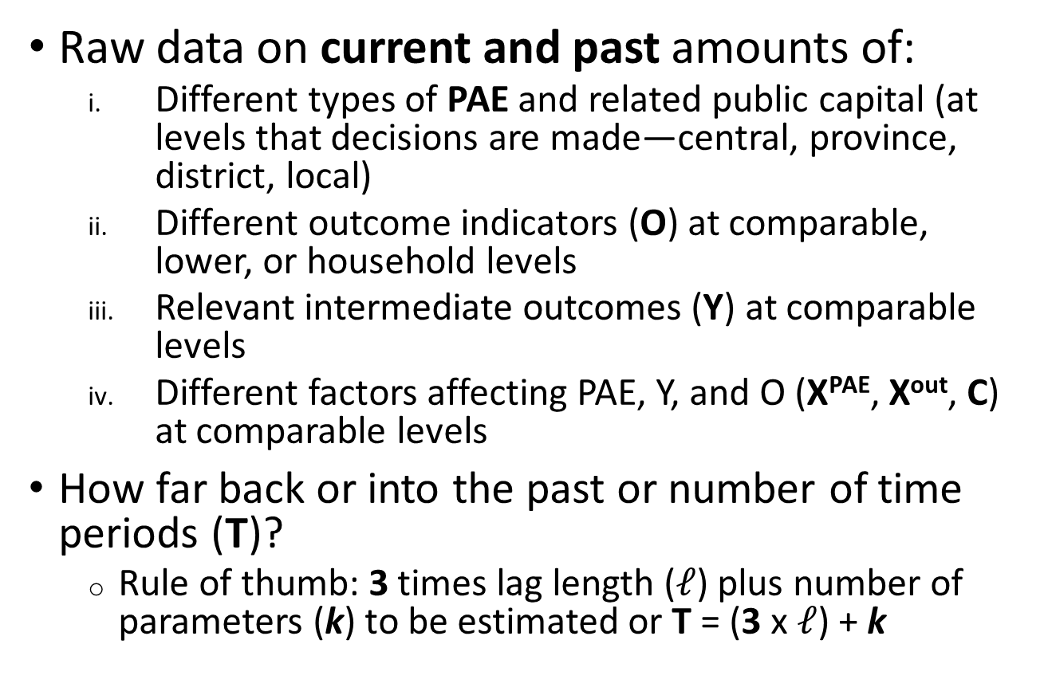
Data needed to estimate effects
Raw data on current and past amounts of:
Different types of PAE and related public capital (at levels that decisions are made—central, province, district, local)
Different outcome indicators (O) at comparable, lower, or household levels
Relevant intermediate outcomes (Y) at comparable levels
Different factors affecting PAE, Y, and O (X^{PAE}, X^{out}, C) at comparable levels
How far back or into the past or number of time periods (T)?
Rule of thumb: 3 times lag length ($ℓ$) plus number of parameters (k) to be estimated or T = (3 x $ℓ$) + k
More later

Slide 17
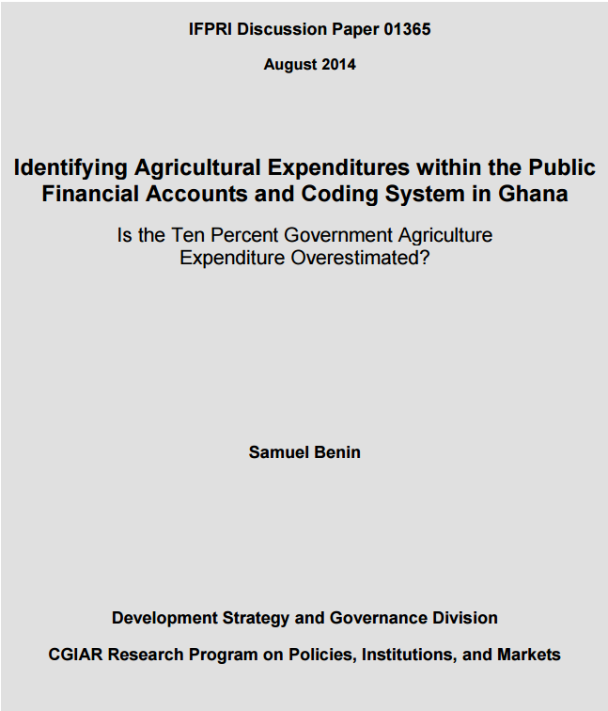
PAE data issues (esp. since CAADP)
Definition of agriculture
Multifunctional agencies
Public: government versus public corporations

Slide 18
PAE accounting issues: case of Ghana
Study and indicators | 2000 | 2001 | 2002 | 2003 | 2004 | 2005 | 2006 | 2007 | 2008 | 2009 | 2010 | 2011
Kolavalli et al. 2010 & Benin et al. 2013
GAE (GHS million) | 30 | 42 | 44 | 79 | 146 | 146
TGE (GHS million) | 661 | 905 | 1119 | 1564 | 2196 | 2516
GAE (% of TE) | 4.6 | 4.7 | 3.9 | 5.0 | 6.7 | 5.8
SEND-Ghana 2010
GAE (GHS million) | 9 | 14 | 37 | 48 | 70 | 182 | 311 | 316 | 322
TGE (GHS million) | 666 | 905 | 760 | 1103 | 1032 | 2516 | 3570 | 3964 | 3843
GAE (% of TE) | 1.4 | 1.5 | 4.9 | 4.3 | 6.8 | 7.3 | 8.7 | 8.0 | 8.4
MOFA 2013
GAE (GHS million) |  | 25 | 37 | 46 | 89 | 114 | 149 | 212 | 315 | 360 | 421 | 516
TGE (GHS million) |  | 382 | 606 | 703 | 1006 | 1193 | 1782 | 2552 | 3951 | 3713 | 2623 | 4586
GAE (% of TE) |  | 6.5 | 6.1 | 6.5 | 8.8 | 9.6 | 8.4 | 8.3 | 8.0 | 9.7 | 16.0 | 11.3
IFPRI 2014¹
GAE (GHS million) | 5 | 11 | 13 | 11 | 13 | 16 | 20 | 26
TGE (GHS million) | 752 | 1200 | 1278 | 1880 | 2603 | 3070 | 4057 | 5662
GAE (% of TE) | 0.7 | 0.9 | 1.0 | 0.6 | 0.5 | 0.5 | 0.5 | 0.5
GAE = government agriculture expenditure
TGE = total government expenditure

Slide 19
PAE accounting issues: case of Ghana
Study and indicators | 2000 | 2001 | 2002 | 2003 | 2004 | 2005 | 2006 | 2007 | 2008 | 2009 | 2010 | 2011
Kolavalli et al. 2010 & Benin et al. 2013
GAE (GHS million) | 30 | 42 | 44 | 79 | 146 | 146
TGE (GHS million) | 661 | 905 | 1119 | 1564 | 2196 | 2516
GAE (% of TE) | 4.6 | 4.7 | 3.9 | 5.0 | 6.7 | 5.8
SEND-Ghana 2010
GAE (GHS million) | 9 | 14 | 37 | 48 | 70 | 182 | 311 | 316 | 322
TGE (GHS million) | 666 | 905 | 760 | 1103 | 1032 | 2516 | 3570 | 3964 | 3843
GAE (% of TE) | 1.4 | 1.5 | 4.9 | 4.3 | 6.8 | 7.3 | 8.7 | 8.0 | 8.4
MOFA 2013
GAE (GHS million) |  | 25 | 37 | 46 | 89 | 114 | 149 | 212 | 315 | 360 | 421 | 516
TGE (GHS million) |  | 382 | 606 | 703 | 1006 | 1193 | 1782 | 2552 | 3951 | 3713 | 2623 | 4586
GAE (% of TE) |  | 6.5 | 6.1 | 6.5 | 8.8 | 9.6 | 8.4 | 8.3 | 8.0 | 9.7 | 16.0 | 11.3
IFPRI 2014¹
GAE (GHS million) | 5 | 11 | 13 | 11 | 13 | 16 | 20 | 26
TGE (GHS million) | 752 | 1200 | 1278 | 1880 | 2603 | 3070 | 4057 | 5662
GAE (% of TE) | 0.7 | 0.9 | 1.0 | 0.6 | 0.5 | 0.5 | 0.5 | 0.5
GAE higher in the Kolavalli et al. and Benin et al. studies
TGE lowest and GAE share highest in MOFA study
Level and share of GAE lowest in the IFPRI data
GAE = government agriculture expenditure
TGE = total government expenditure

Slide 20
PAE accounting issues: case of Ghana cont’d
Accounting changed over time: Is it to show compliance with CAADP 10% target? Or is effectiveness of portfolio considered?
Although it also reflects changing role of MDAs in the sector.
Notes:
Animation:
Prior to CAADP (shown here in years 200 and 2001), only counted expenditures on crops & livestock, Forestry, Fisheries and Research
After that, included expenditures on cocoa, presidential special initiative (PSI), and debt service
More recently included expenditures on feeder roads and Millennium Challenge Account

Slide 21
Definition of agriculture and PAE
African Union (AU) Technical Note: production of crops, livestock, forestry, and fishing
Follows IMF classification of functions of government (COFOG, IMF 2000)
Function, sub-function, activity
704 Economic affairs 7042 Agriculture, forestry, and fishing and hunting
70421 Agriculture (crops and livestock) ...excludes multipurpose development projects (70474).
70422 Forestry ...includes forest crops in addition to timber.
70423 Fishing and hunting ...excludes control of offshore and ocean fishing (70310); administration, operation, or support of natural parks and reserves (70540).

Slide 22
Multifunctional expenditures
Function, sub-function, activity
704 Economic affairs 7047 Other industries
70474 Multipurpose development projects …typically consist of integrated facilities for generation of power, flood control, irrigation, navigation, and recreation. …excludes projects with one main function and other functions that are secondary (classified according to main function).
7048 R&D economic affairs
70482 R&D agriculture, forestry, and fishing and hunting …excludes basic research (70140).
Key question: what share of public expenditure on such projects should be counted as PAE?

Slide 23
Addressing multifunctional issues
Multifunctional expenditure (e.g. hydroelectricity and irrigation)
Allocate across sectors based on functional analysis using bandwidth for low- and high-end values
Multifunctional implementing agencies
Allocate based on functional analysis of e.g. staff time, using bandwidth for low- and high-end values
Include R&D on agriculture, forestry, and fishing by research institutes and universities

Slide 24
Government and public corporations
Public Sector
General Government
Public Corporations
Central government
Financial PCs
Nonfinancial PCs
State government
Monetary financial PCs (incl. central bank)
Local government
Nonmonetary financial PCs
AU Technical Note: exclude expenditures of public corporations from government expenditure
Because government accounts are presented on a consolidated basis; which includes net transaction with public corporations.

Slide 25
Raw disaggregated historical data
Functions (COFOG)
701. Gen. Pub. Services
702. Defense
703. Pub. Order & Safety
704. Economic Affairs
705. Environ Protection
706. Housing & Community Amenities
707. Health
708. Rec., Culture, & Rel.
709. Education
710. Social Protection
Economic classification
21. Compensation of employees
22. Use of goods and services
23. Consumption of fixed capital
24. Interest
25. Subsidies
26. Grants
27. Social benefits
28. Other
Agricultural sub-sector
Crops
Livestock
Forestry
Fishery
Agricultural sub-functions
Extension
Research
Irrigation
Land management
Market infrastructure
Farm support
Policy, planning, M&E
Regulation, licensing
Statistics
…
Level
Central
State/Region
Local/District
…
Policy objective
Food security
Productivity/Growth
…
Target
Demography
Geography
…
Source of financing
Domestic (loan, tax)
External (loan, grant)
Planning/Execution
Budget
Expenditure
Notes:
Also implied in the CAADP NAIPs as the different budgets are allocated differently according to the different classifications

Slide 26
Part 1b: PAE national and cross-country database initiatives

Slide 27
Sample national and cross-country
Kenya: https://www.opendata.go.ke/Expenditure-National-/Public-Expenditure-2002-2010/n28e-myf3
SPEED: https://public.tableau.com/profile/ifpri.td7290#!/vizhome/2015SPEED/Overview
ReSAKSS: http://www.resakss.org/map/

Slide 28
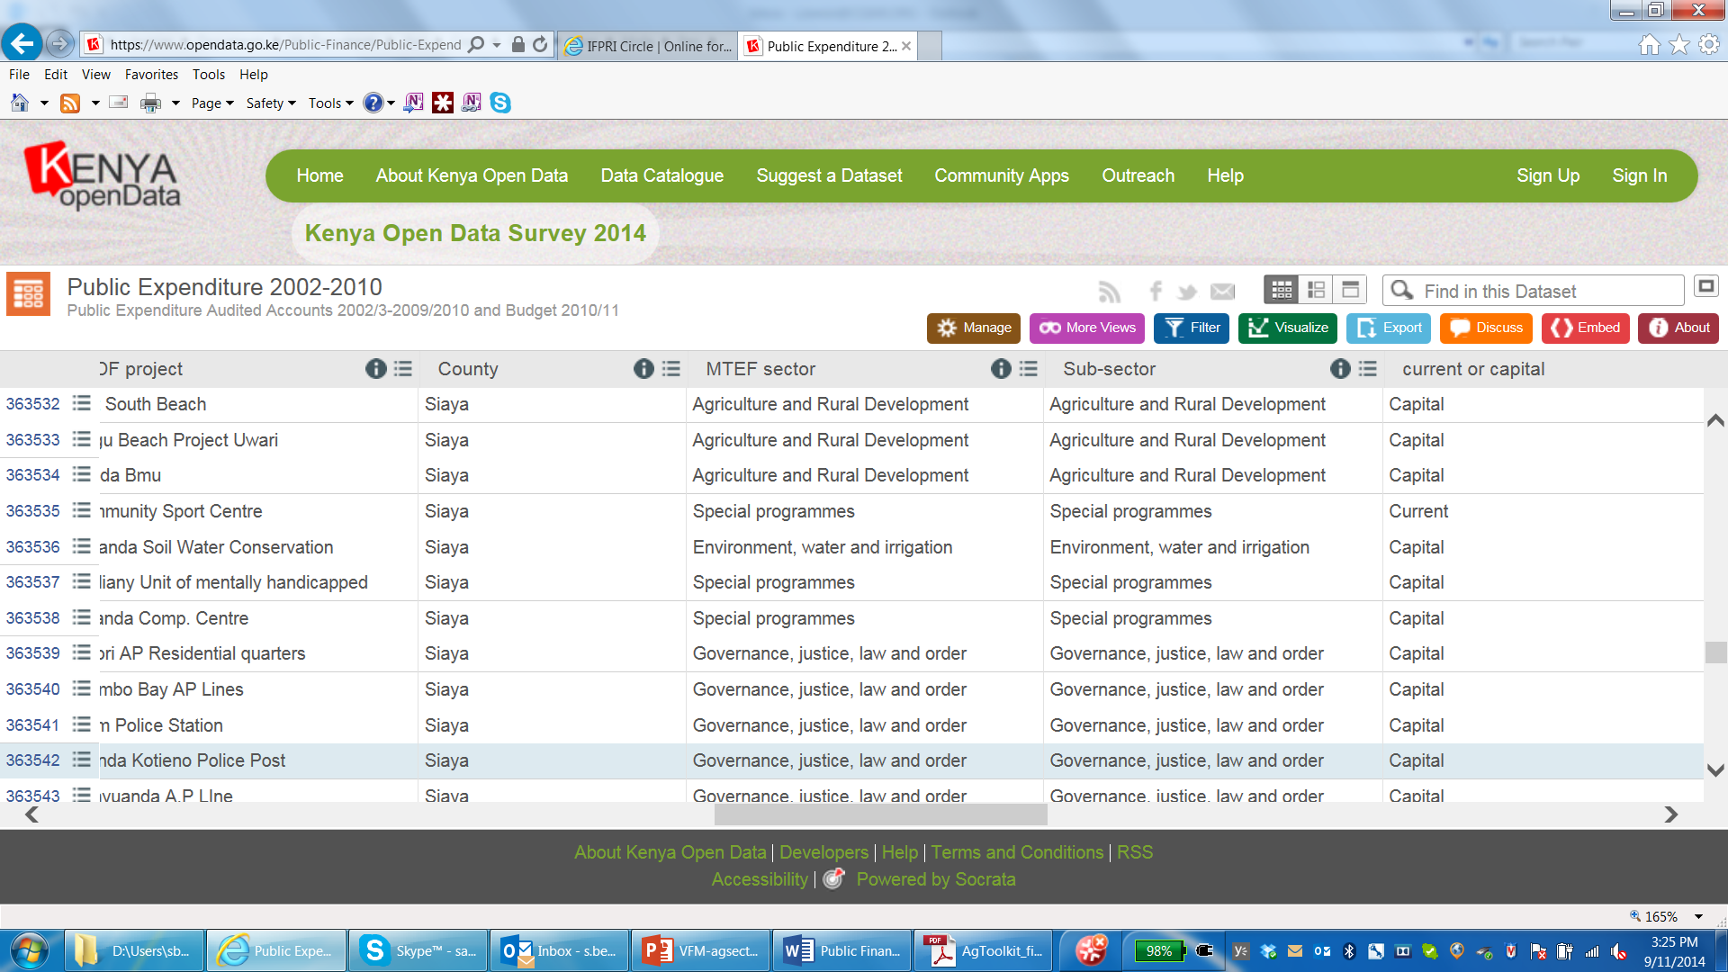
Kenyan example of a good publicly available data system
https://www.opendata.go.ke/Public-Finance/Public-Expenditure-2002-2010/n28e-myf3

Slide 29
Kenyan example–cont’d
Variable Name | Description (remarks)
Year | 2002/03–2010/11
Central/Sub-national | Three categories or levels: Constituencies Development Fund (CDF), Central, Local Authorities
Vote | Line ministries, legislative bodies, municipalities, councils and constituencies
Sub-Vote | Different department and service units within the central-level Vote
Head | Different agencies and programs with the central-level Vote and Sub-Vote
sub-Head | Different implementation units and projects within the central-level Vote, Sub-Vote, Head
County | Names of counties
District | Names of districts
CDF project | Names of projects within the CDFs
MTEF sector | 11 sectors identified in medium term expenditure framework
Sub-sector | Total of 34 sub-sectors by breaking down each sector into 2–4
Current or capital | Expenditures classified into four groups: capital, current, interest, other
GFS classification | Expenditures and revenues classified into 17 groups
Line item | Details description of expenditures and receipts
Estimates | Budget and revenue estimates in KShs
Revised | Revised budget and revenue estimates in KShs
Executed | Actual expenditures and revenues in KShs
Budget Type | Classified into two: development and recurrent
A-in-A | Appropriation in Aid (supported by the use of internally-generated income)
Location_1 | Unknown and empty
https://www.opendata.go.ke/Public-Finance/Public-Expenditure-2002-2010/n28e-myf3

Slide 30
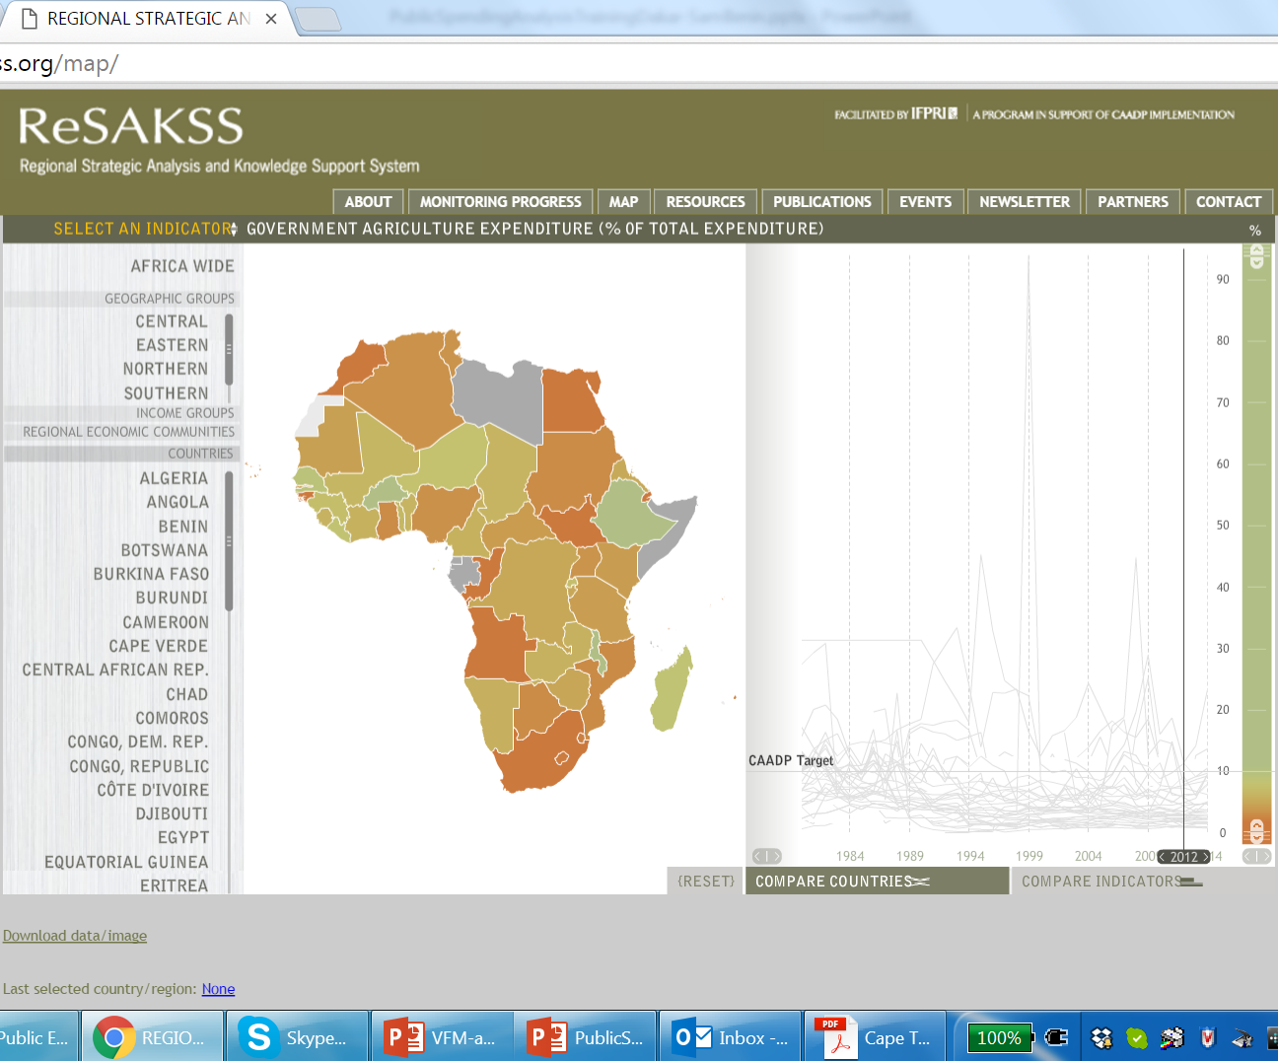
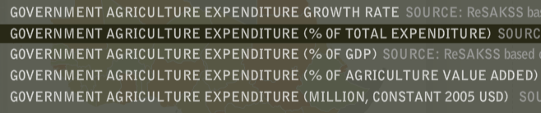
ReSAKSS: data on PAE in Africa from 1980 …

Slide 31
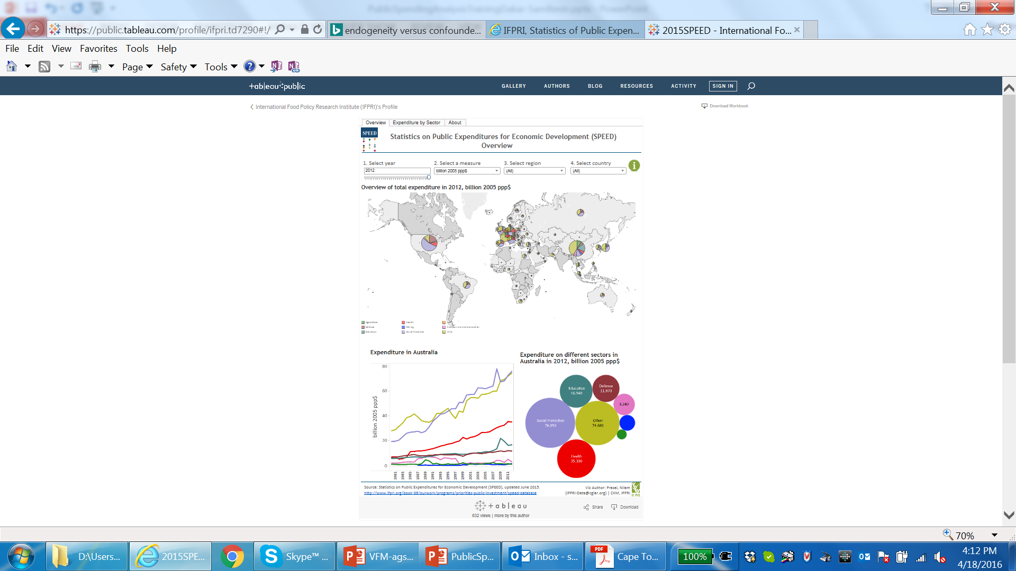
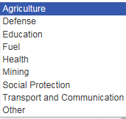
SPEED: data on PAE and 8 other sectors in the world (145 countries) from 1980 …

Slide 32
Mogues et al. 2016
Compares 13 cross-country data initiatives that include PAE
Compares methods, scope, etc. and provides statistics on PAE

Slide 33
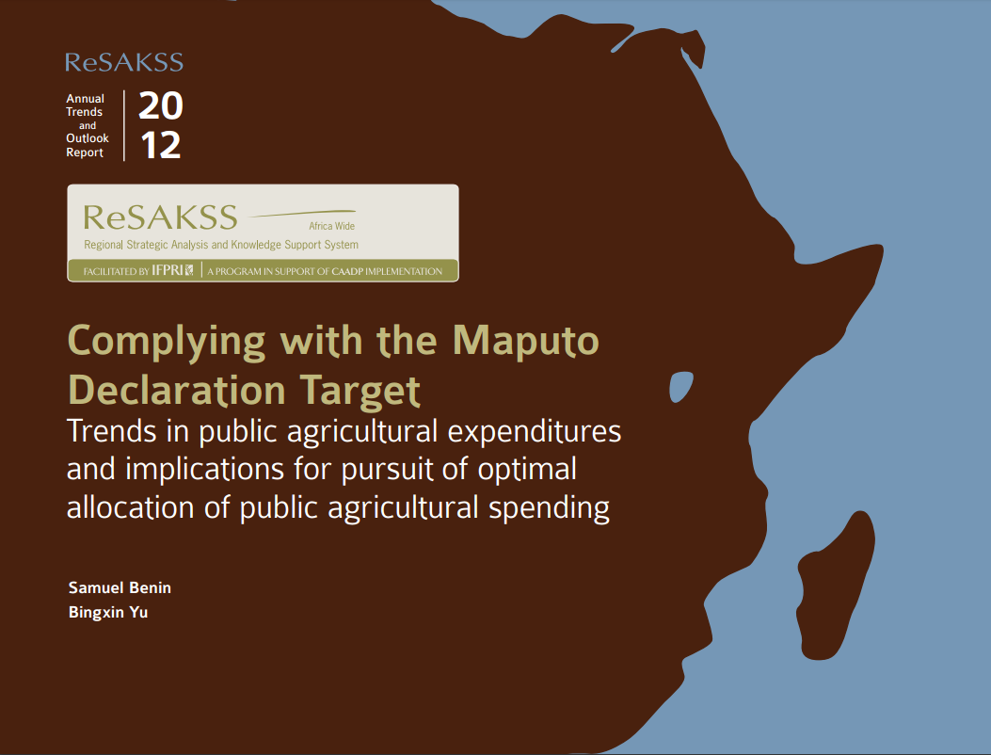
Part 2a: trend analysis
PAE performance against targets
PAE consistency with policies and strategies

Slide 34
Terminology
GAE = Government Agriculture Expenditure
TGE = Total Government Expenditure
CAE = Public Corporation Agriculture Expenditure
TCE = Total Public Corporation Expenditure
PAE = Public Agriculture Expenditure
TPE = Total Public Expenditure
PAE = GAE + CAE
TPE = TGE + TCE
without double counting

Slide 35
Performance against targets
Commitment to agricultural sector:
Compare GAE growth to TGE or agGDP growth to assess commitment to agricultural sector relative to others
Analyze GAE growth by sub-periods to assess commitment by different governments or policies
Budget execution:
Ratio of actual expenditure to budget
Sources of financing: relative taxation of agriculture; timing of releases; public-private partnerships
Commitment to CAADP and AU targets:
GAE/TGE or PAE/TPE vis-à-vis CAADP 10% target
Share of research expenditure in agriculture value added vis-à-vis AU 1% target

Slide 36
Consistency with policies
Economic: inductive analysis (e.g.: wage vs. non-wage; recurrent vs. capital) to assess relative build up of productive assets
Result area, sub-sector, or sub-function: assess consistency with investment plan or strategic direction of spending
Level (central vs. district): assess deconcentration of fiscal policy
Target population: calculate per capita expenditures for different socio-demographic groups (or benefit incidence analysis) to assess e.g. gender focus of expenditures

Slide 37
Part 2b:
Efficiency of PAE—provision of public G&S
Effectiveness of PAE—impacts or returns

Slide 38
Analysis of cost effectiveness
With data on output, e.g. number of farmers trained by extension, estimate unit cost of training one farmer for different locations.
Cost of providing extension services in selected regions in Ghana, 2006
 | Brong-Ahafo | Northern | Western
Costs (GH¢)
Salaries and benefits | 2,061,752 | 2,264,505 | 1,841,860
Operations | 203,744 | 223,780 | 182,014
Overhead ª | 124,959 | 137,247 | 111,631
Total | 2,390,455 | 2,625,532 | 2,135,506
Achievements
Number home and farm visits | 20,871 | 71,934 | 29,076
Number of demonstrations | 6,012 | 628 | 1,600
Number of farmers trained | 58,175 | 45,526 | 23,750
Unit cost (GH¢ per farmer reached) ^{b}
Equally-weighted achievements ^{c} | 52 | 64 | 93
Unequally-weighted achievements ^{d} | 66 | 51 | 85
Source: Kolavalli et al. 2010
Notes:
ª based on 11% total headquarters (including directorates) expenditure allocation to the Extension Services Directorate, and 9.5%, 10.5% and 8.5% of total RADU and DADU expenditure allocation to the Brong-Ahafo, Northern and Western RADUs and DADUs, respectively; ^{b} assume 10 farmers reached in each demonstration; ^{c} assume equal weights to home visits, demonstrations and training in terms of time spent by AEA in those activities; ^{d} assume more weight to home visits (60%), demonstrations (25%), and training (15%).

Slide 39
Analysis of cost effectiveness
With data on output, e.g. number of farmers trained by extension, estimate unit cost of training one farmer for different locations.
Cost of providing extension services in selected regions in Ghana, 2006
 | Brong-Ahafo | Northern | Western
Costs (GH¢)
Salaries and benefits | 2,061,752 | 2,264,505 | 1,841,860
Operations | 203,744 | 223,780 | 182,014
Overhead ª | 124,959 | 137,247 | 111,631
Total | 2,390,455 | 2,625,532 | 2,135,506
Achievements
Number home and farm visits | 20,871 | 71,934 | 29,076
Number of demonstrations | 6,012 | 628 | 1,600
Number of farmers trained | 58,175 | 45,526 | 23,750
Unit cost (GH¢ per farmer reached) ^{b}
Equally-weighted achievements ^{c} | 52 | 64 | 93
Unequally-weighted achievements ^{d} | 66 | 51 | 85
Cost of providing extension and reaching farmers is very high in the Western Region, Why?
Although extension agents in the Western Region (based on the district used) cover a relatively smaller area and so travel relatively shorter distances, they have much fewer motorbikes and they reach much fewer farmers than in the other two areas.
Source: Kolavalli et al. 2010
Notes:
ª based on 11% total headquarters (including directorates) expenditure allocation to the Extension Services Directorate, and 9.5%, 10.5% and 8.5% of total RADU and DADU expenditure allocation to the Brong-Ahafo, Northern and Western RADUs and DADUs, respectively; ^{b} assume 10 farmers reached in each demonstration; ^{c} assume equal weights to home visits, demonstrations and training in terms of time spent by AEA in those activities; ^{d} assume more weight to home visits (60%), demonstrations (25%), and training (15%).

Slide 40
End of Day 1
Thank You

