Slide 1
Public Agriculture Expenditure (PAE) Analysis concepts, methods and tools, & applications
Sam Benin, IFPRI
Training for PAPA Project Collaborators
19-20 April 2016, IFPRI-Dakar, Senegal

Slide 2
Outline
Concepts (1.5-2 hours)
  Rationale for public spending in the gricultural sector
  Key issues and policy questions
Data needs, methods, and tools (6-7 hours)
  PAE data requirements, issues, initiatives
  Trends analysis—PAE performance against targets and consistency with policies and strategies
  Efficiency and effectiveness of PAE
Applications (1.5-2 hours)
  Costing, budgeting, prioritization

Slide 3

Key concepts (1.5-2 hours)
Good discussion of rationale in this journal article:
Mogues, Fan and Benin, (2015) 27, 337–352

Slide 4
Statement of PE allocation
Gov’t of Uganda, Poverty Eradication Action Plan, 2004
The demands for PE always outstrip the resources … available to fund them. ... If PE is to maximize its contribution to the PEAP, … three conditions …[be] met:
  Inter-sectoral budget allocations be shifted in favor of those sectors which can make the strongest contributions to … accelerating pro-poor growth, ….
  Intra-sectoral budget allocations be shifted in favor of projects and programs which most clearly contribute to poverty eradication in a cost effective manner.
  Efficiency is improved in all areas of PE, so that better value for money … can be achieved with the scarce resources ….

Slide 5
Why public spending in agriculture?
Rationale for PE in general derives from two main sources:
  Economic inefficiencies because of market failures due to characteristics of goods and services (G&S) and market participants that create divergence between social and private net benefits (characteristics = public goods, externalities, information asymmetries, imperfect markets)
  Inequality in the distribution of G&S due to how resources were initially allocated. In agriculture, G&S are typically biased against majority of people who live in rural areas and depend on agriculture for their livelihoods

Slide 6
Efficiency rationale
Public good issues
  Non-rivalry (one’s consumption does not reduce amount others can consume) and non-excludability (no one can be excluded)
  Those G&S underprovided by private agents (e.g. basic R&D germ plasm, markets/favorable prices at harvest)
  Government can subsidize basic R&D or invest in market infrastructure
Externalities
  Producer does not bear full cost (e.g. pollution) or capture full benefits (e.g. pollination)
  More G&S with negative externalities produced and less of those G&S with positive externalities
  Gov’t can tax/regulate G&S with negative externalities and subsidize G&S with positive externalities

Slide 7
Efficiency rationale – cont’d
Imperfect information/information asymmetries
  One party has more/better information than the other leading to inefficient production and transactions
  Weather risk: poor information ➔ uniform premium ➔ unattractive to and excludes lower-risk farmers ➔ more higher-risk farmers ➔ moral hazard/undertake more-riskier activities ➔ expensive premiums ➔ vicious cycle
  Gov’t can invest in information that help private sector to better provide localized premiums
Imperfect competition
  Monopoly/oligopoly due to large search/entry/exit costs
  Similar goernment intervention as above
Others/emerging: gov’t is public good; climate change

Slide 8
Equity rationale
Two main concerns:
  Improve status of people with low levels of welfare – as with objectives of reducing poverty, improving food security
  Narrow gap between those with higher levels of welfare and those with lower levels – objective of reducing inequality
This is important for agriculture sector because:
  Most of poor work in the sector and in rural areas
  Employs bulk of labor and accounts for large share of GDP
  Evidence that public agriculture investment (particularly in R&D) has large poverty-reducing effects
Government direct transfers (cash, kind, subsidies) to target households to protect their productive assets and subsidize their consumption

Slide 9
Maputo Declaration & key issues
Bold move in Maputo Declaration—African governments’ commitment to spend 10% of national expenditure on agriculture—is not surprising
Key issues (recall Ugandan PE allocation statement)
  African leaders have also signed other charters:
    2001 Abuja Declaration on health—15% of budget
    2007 Year of Science & Technology—1% GDP
  Difficult to see how significant shifts in sectorial expenditures may be done to achieve CAADP 10% target

Slide 10
Key PE or fiscal policy questions
Given current levels of spending, what types of PAE should be prioritized to achieve development objectives?
How much it will cost to, for example:
  raise agricultural sector growth from 4% to 6% by 2025?
  reduce rural poverty by half by 2025?
  eliminate hunger by 2025?
These are questions we would like PAE analysis to ultimately help answer

Slide 11

Effect of PAE, conceptual framework
R
Rural poverty
N
R′
Pages 27-35
Q
F
Rural income
M
Q′
E
Input and output prices,
Rural wages
O
D
J
Rural non-farm production and productivity
L
C
L′
I
K
H
Depends on link between two decision-making processes (1) PAE and (2) household agricultural production and consumption
P
B_{nag}
Agricultural production and productivity
G
Private-sector investments
G/H
P′
B_{ag}
Public capital: agricultural technologies, human capital, rural infrastructure (roads, irrigation, market information, electricity, etc.)
A
Spending on safety nets (e.g. food aid, food/cash-for-work)
Spending on agriculture (e.g. research, extension, irrigation, farm subsidies)
Spending on infrastructure (e.g. roads, markets, electricity)
Spending on social services (e.g. health, education, water)

Slide 12
Conceptual framework – cont’d
Fundamental notion: public and private capital are complements in production process; PAE that increases the public capital stock would raise productivity of all factors in production
Various pathways:
  Technology advancing (e.g. R&D)
  Human capital enhancing (e.g. extension)
  Transactions cost reducing (e.g. markets, feeder roads)
  Crowding-in of private capital (e.g. irrigation)
Effect on different outcomes are not the same for all types of PAE; some may not be productive at all
Effects are different in different locations (conditioning factors)
Effect takes time to materialize; effect of different types of PAE materialize at different times

Slide 13
Behavior of decision makers
Government, public agents, politicians
  Spend more in areas with higher productive potential (efficiency rationale) or more in poorer areas or where public G&S are low (equity rationale)
  Spend more on PAE types or in areas with quicker and more visible returns or attributable to spending agent
  Spend more in areas to sustain or sway political support
  Spend competitively or complementary (neighborhood effects)
Households/producers, unclear depends on model: unitary, collective, cooperative, non-cooperative
  Crowd-in or crowd-out own investment or input
  Entry or exit options out of agriculture

Slide 14
Endogeneity & confoundedness
These issues arise to the extent that:
  PAE decision is influenced by the outcome
  PAE and outcome are influenced by same factors (C)
direct effect
indirect effect
PAE
Y
Outcome
endogeneity
X^{PAE}
C
X^{out}
confoundedness
Total Net Effect $=\frac{∆Outcome}{∆PAE}+\frac{∆Y}{∆PAE}\frac{∆Outcome}{∆Y}|X^{PAE},X^{out},E,C$

Slide 15
Data needs, methods, and tools (6-7 hours)
Part 1
PAE data requirements and issues
PAE national and cross-country database initiatives
Part 2
Trends analysis—PAE performance against targets and consistency with policies and strategies
Efficiency and effectiveness of PAE

Slide 16
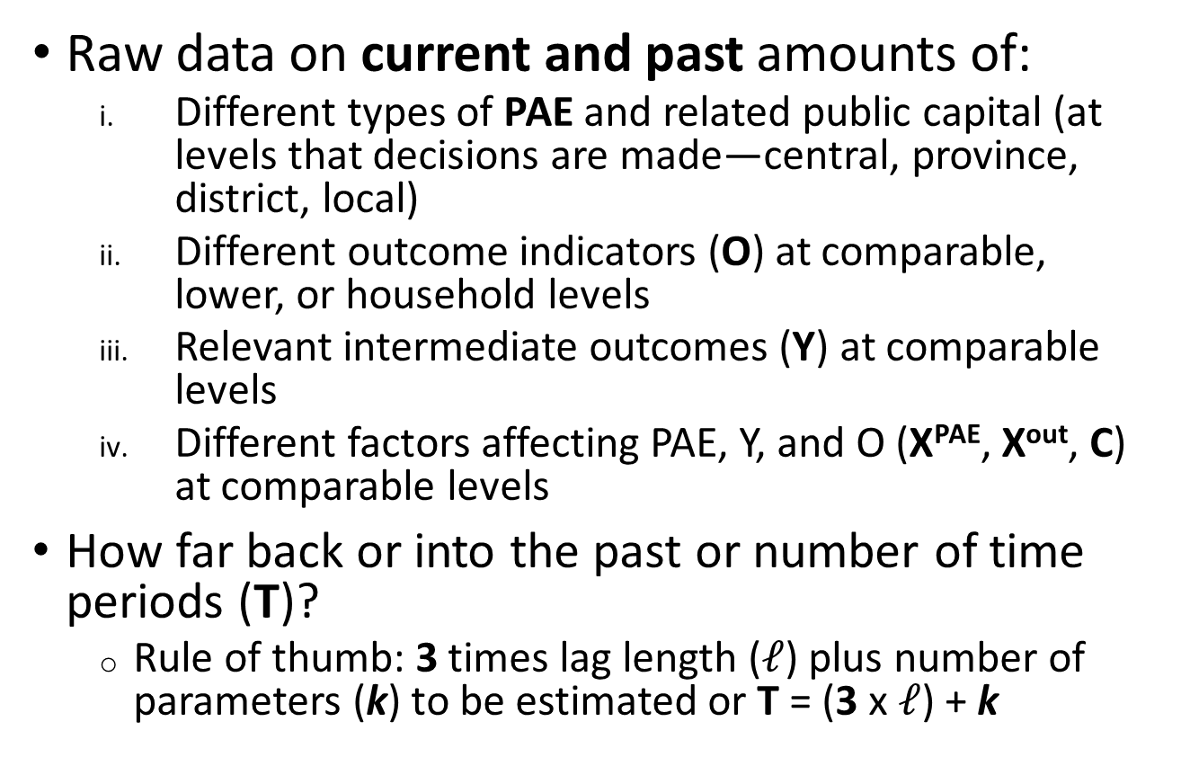
Data needed to estimate effects
Raw data on current and past amounts of:
  Different types of PAE and related public capital (at levels that decisions are made—central, province, district, local)
  Different outcome indicators (O) at comparable, lower, or household levels
  Relevant intermediate outcomes (Y) at comparable levels
  Different factors affecting PAE, Y, and O (X^{PAE}, X^{out}, C) at comparable levels
How far back or into the past or number of time periods (T)?
  Rule of thumb: 3 times lag length ($ℓ$) plus number of parameters (k) to be estimated or T = (3 x $ℓ$) + k
More later

Slide 17
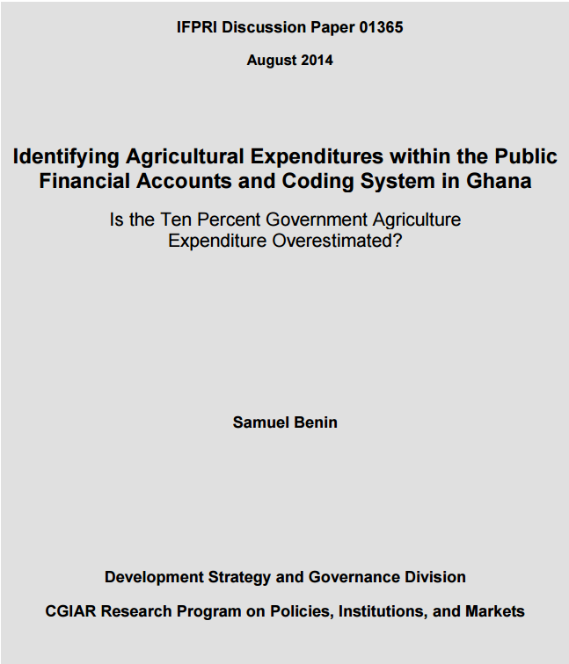
PAE data issues (esp. since CAADP)
Definition of agriculture
Multifunctional agencies
Public: government versus public corporations

Slide 18
PAE accounting issues: case of Ghana
Study and indicators | 2000 | 2001 | 2002 | 2003 | 2004 | 2005 | 2006 | 2007 | 2008 | 2009 | 2010 | 2011
Kolavalli et al. 2010 & Benin et al. 2013
GAE (GHS million) | 30 | 42 | 44 | 79 | 146 | 146
TGE (GHS million) | 661 | 905 | 1119 | 1564 | 2196 | 2516
GAE (% of TE) | 4.6 | 4.7 | 3.9 | 5.0 | 6.7 | 5.8
SEND-Ghana 2010
GAE (GHS million) | 9 | 14 | 37 | 48 | 70 | 182 | 311 | 316 | 322
TGE (GHS million) | 666 | 905 | 760 | 1103 | 1032 | 2516 | 3570 | 3964 | 3843
GAE (% of TE) | 1.4 | 1.5 | 4.9 | 4.3 | 6.8 | 7.3 | 8.7 | 8.0 | 8.4
MOFA 2013
GAE (GHS million) |  | 25 | 37 | 46 | 89 | 114 | 149 | 212 | 315 | 360 | 421 | 516
TGE (GHS million) |  | 382 | 606 | 703 | 1006 | 1193 | 1782 | 2552 | 3951 | 3713 | 2623 | 4586
GAE (% of TE) |  | 6.5 | 6.1 | 6.5 | 8.8 | 9.6 | 8.4 | 8.3 | 8.0 | 9.7 | 16.0 | 11.3
IFPRI 2014¹
GAE (GHS million) | 5 | 11 | 13 | 11 | 13 | 16 | 20 | 26
TGE (GHS million) | 752 | 1200 | 1278 | 1880 | 2603 | 3070 | 4057 | 5662
GAE (% of TE) | 0.7 | 0.9 | 1.0 | 0.6 | 0.5 | 0.5 | 0.5 | 0.5
GAE = government agriculture expenditure
TGE = total government expenditure

Slide 19
PAE accounting issues: case of Ghana
Study and indicators | 2000 | 2001 | 2002 | 2003 | 2004 | 2005 | 2006 | 2007 | 2008 | 2009 | 2010 | 2011
Kolavalli et al. 2010 & Benin et al. 2013
GAE (GHS million) | 30 | 42 | 44 | 79 | 146 | 146
TGE (GHS million) | 661 | 905 | 1119 | 1564 | 2196 | 2516
GAE (% of TE) | 4.6 | 4.7 | 3.9 | 5.0 | 6.7 | 5.8
SEND-Ghana 2010
GAE (GHS million) | 9 | 14 | 37 | 48 | 70 | 182 | 311 | 316 | 322
TGE (GHS million) | 666 | 905 | 760 | 1103 | 1032 | 2516 | 3570 | 3964 | 3843
GAE (% of TE) | 1.4 | 1.5 | 4.9 | 4.3 | 6.8 | 7.3 | 8.7 | 8.0 | 8.4
MOFA 2013
GAE (GHS million) |  | 25 | 37 | 46 | 89 | 114 | 149 | 212 | 315 | 360 | 421 | 516
TGE (GHS million) |  | 382 | 606 | 703 | 1006 | 1193 | 1782 | 2552 | 3951 | 3713 | 2623 | 4586
GAE (% of TE) |  | 6.5 | 6.1 | 6.5 | 8.8 | 9.6 | 8.4 | 8.3 | 8.0 | 9.7 | 16.0 | 11.3
IFPRI 2014¹
GAE (GHS million) | 5 | 11 | 13 | 11 | 13 | 16 | 20 | 26
TGE (GHS million) | 752 | 1200 | 1278 | 1880 | 2603 | 3070 | 4057 | 5662
GAE (% of TE) | 0.7 | 0.9 | 1.0 | 0.6 | 0.5 | 0.5 | 0.5 | 0.5
GAE higher in the Kolavalli et al. and Benin et al. studies
TGE lowest and GAE share highest in MOFA study
Level and share of GAE lowest in the IFPRI data
GAE = government agriculture expenditure
TGE = total government expenditure

Slide 20
PAE accounting issues: case of Ghana cont’d
Accounting changed over time: Is it to show compliance with CAADP 10% target? Or is effectiveness of portfolio considered?
Although it also reflects changing role of MDAs in the sector.
Notes:
Animation:
Prior to CAADP (shown here in years 200 and 2001), only counted expenditures on crops & livestock, Forestry, Fisheries and Research
After that, included expenditures on cocoa, presidential special initiative (PSI), and debt service
More recently included expenditures on feeder roads and Millennium Challenge Account

Slide 21
Definition of agriculture and PAE
African Union (AU) Technical Note: production of crops, livestock, forestry, and fishing
Follows IMF classification of functions of government (COFOG, IMF 2000)
Function, sub-function, activity
704 Economic affairs 7042 Agriculture, forestry, and fishing and hunting
70421 Agriculture (crops and livestock) ...excludes multipurpose development projects (70474).
70422 Forestry ...includes forest crops in addition to timber.
70423 Fishing and hunting ...excludes control of offshore and ocean fishing (70310); administration, operation, or support of natural parks and reserves (70540).

Slide 22
Multifunctional expenditures
Function, sub-function, activity
704 Economic affairs 7047 Other industries
70474 Multipurpose development projects …typically consist of integrated facilities for generation of power, flood control, irrigation, navigation, and recreation. …excludes projects with one main function and other functions that are secondary (classified according to main function).
7048 R&D economic affairs
70482 R&D agriculture, forestry, and fishing and hunting …excludes basic research (70140).
Key question: what share of public expenditure on such projects should be counted as PAE?

Slide 23
Addressing multifunctional issues
Multifunctional expenditure (e.g. hydroelectricity and irrigation)
  Allocate across sectors based on functional analysis using bandwidth for low- and high-end values
Multifunctional implementing agencies
  Allocate based on functional analysis of e.g. staff time, using bandwidth for low- and high-end values
Include R&D on agriculture, forestry, and fishing by research institutes and universities

Slide 24
Government and public corporations
Public Sector
General Government
Public Corporations
Central government
Financial PCs
Nonfinancial PCs
State government
Monetary financial PCs (incl. central bank)
Local government
Nonmonetary financial PCs
AU Technical Note: exclude expenditures of public corporations from government expenditure
  Because government accounts are presented on a consolidated basis; which includes net transaction with public corporations.

Slide 25
Raw disaggregated historical data
Functions (COFOG)
701. Gen. Pub. Services
702. Defense
703. Pub. Order & Safety
704. Economic Affairs
705. Environ Protection
706. Housing & Community Amenities
707. Health
708. Rec., Culture, & Rel.
709. Education
710. Social Protection
Economic classification
21. Compensation of employees
22. Use of goods and services
23. Consumption of fixed capital
24. Interest
25. Subsidies
26. Grants
27. Social benefits
28. Other
Agricultural sub-sector
Crops
Livestock
Forestry
Fishery
Agricultural sub-functions
Extension
Research
Irrigation
Land management
Market infrastructure
Farm support
Policy, planning, M&E
Regulation, licensing
Statistics
…
Level
Central
State/Region
Local/District
…
Policy objective
Food security
Productivity/Growth
…
Target
Demography
Geography
…
Source of financing
Domestic (loan, tax)
External (loan, grant)
Planning/Execution
Budget
Expenditure
Notes:
Also implied in the CAADP NAIPs as the different budgets are allocated differently according to the different classifications

Slide 26
Part 1b: PAE national and cross-country database initiatives

Slide 27
Sample national and cross-country
Kenya: https://www.opendata.go.ke/Expenditure-National-/Public-Expenditure-2002-2010/n28e-myf3
SPEED: https://public.tableau.com/profile/ifpri.td7290#!/vizhome/2015SPEED/Overview
ReSAKSS: http://www.resakss.org/map/

Slide 28
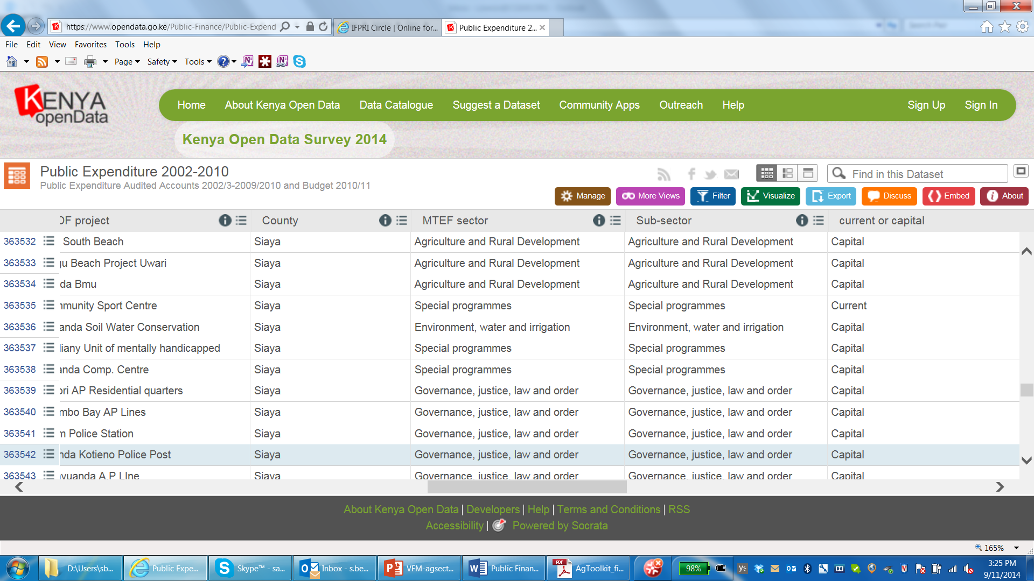
Kenyan example of a good publicly available data system
https://www.opendata.go.ke/Public-Finance/Public-Expenditure-2002-2010/n28e-myf3

Slide 29
Kenyan example–cont’d
Variable Name | Description (remarks)
Year | 2002/03–2010/11
Central/Sub-national | Three categories or levels: Constituencies Development Fund (CDF), Central, Local Authorities
Vote | Line ministries, legislative bodies, municipalities, councils and constituencies
Sub-Vote | Different department and service units within the central-level Vote
Head | Different agencies and programs with the central-level Vote and Sub-Vote
sub-Head | Different implementation units and projects within the central-level Vote, Sub-Vote, Head
County | Names of counties
District | Names of districts
CDF project | Names of projects within the CDFs
MTEF sector | 11 sectors identified in medium term expenditure framework
Sub-sector | Total of 34 sub-sectors by breaking down each sector into 2–4
Current or capital | Expenditures classified into four groups: capital, current, interest, other
GFS classification | Expenditures and revenues classified into 17 groups
Line item | Details description of expenditures and receipts
Estimates | Budget and revenue estimates in KShs
Revised | Revised budget and revenue estimates in KShs
Executed | Actual expenditures and revenues in KShs
Budget Type | Classified into two: development and recurrent
A-in-A | Appropriation in Aid (supported by the use of internally-generated income)
Location_1 | Unknown and empty
https://www.opendata.go.ke/Public-Finance/Public-Expenditure-2002-2010/n28e-myf3

Slide 30
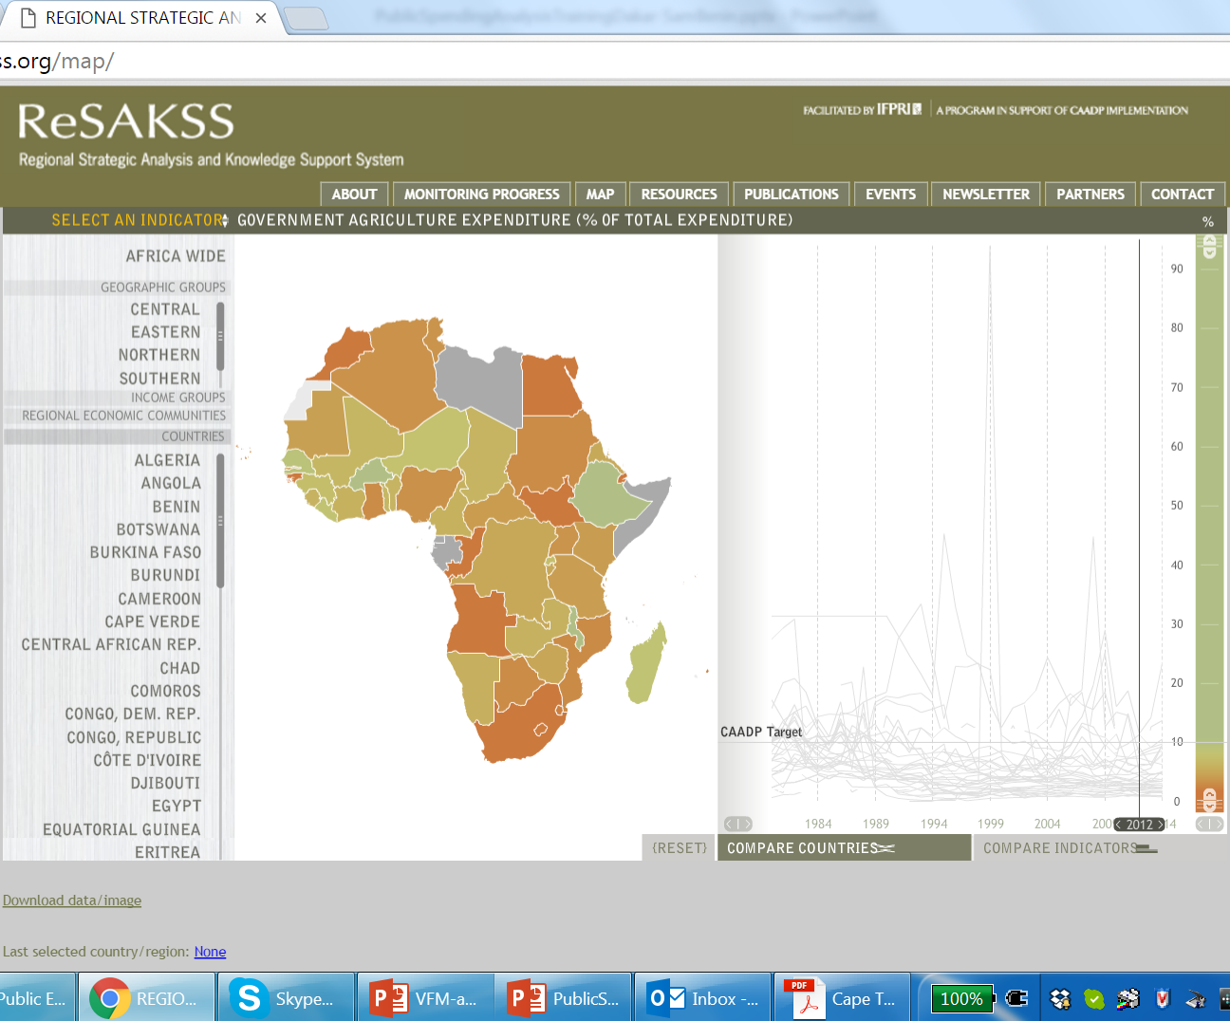
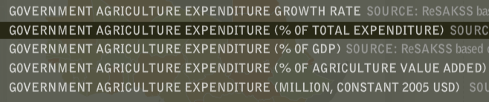
ReSAKSS: data on PAE in Africa from 1980 …

Slide 31
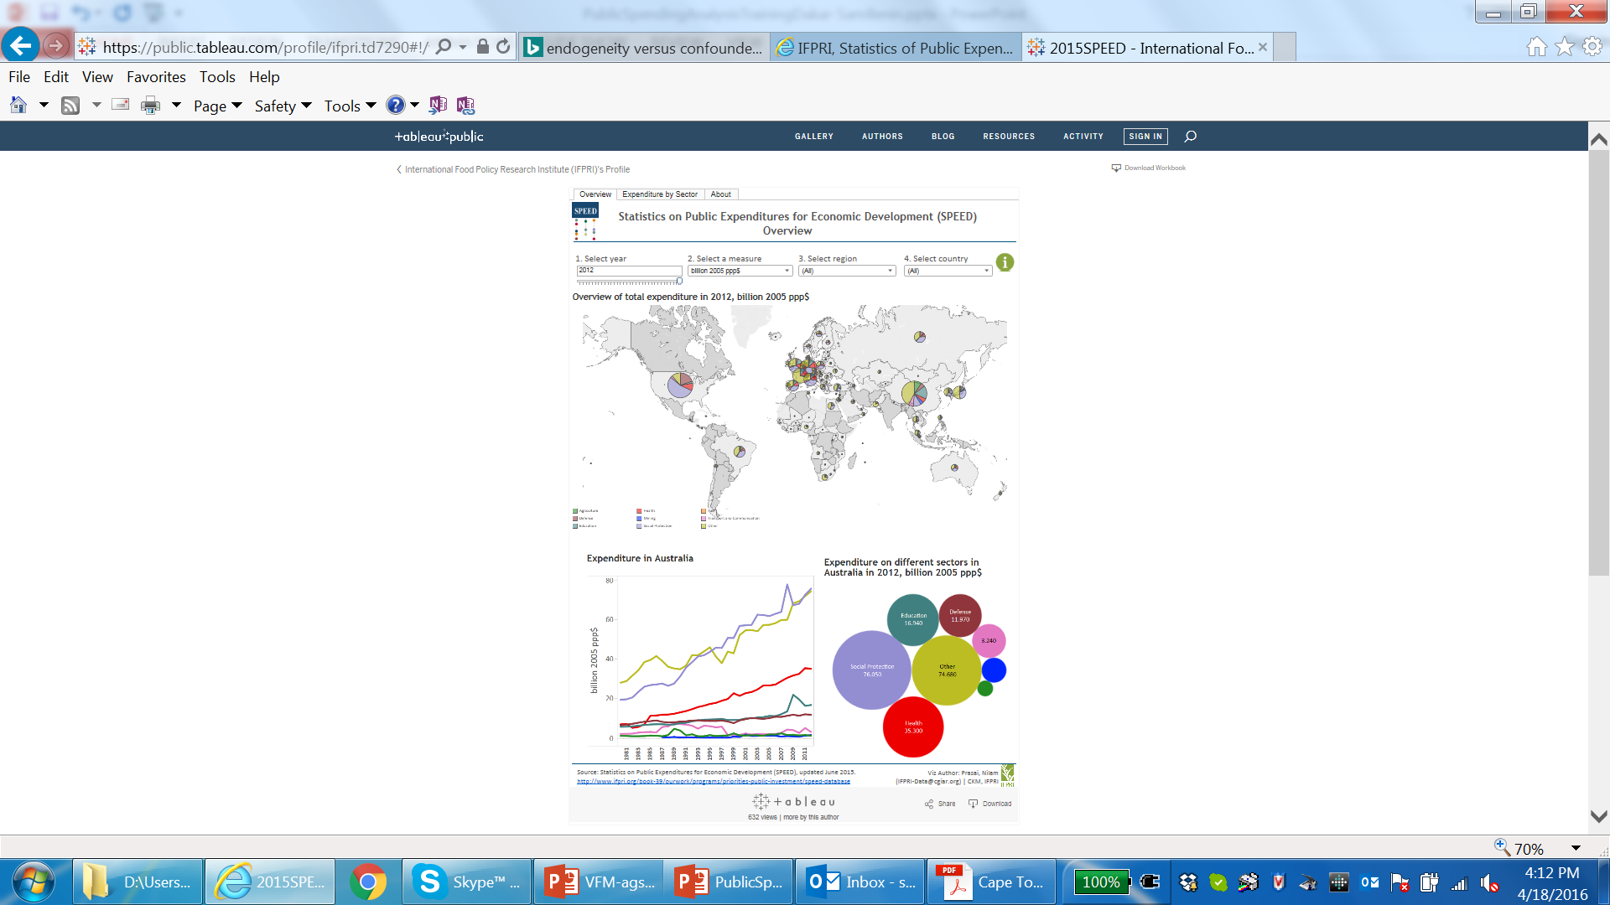
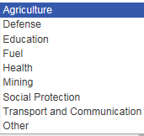
SPEED: data on PAE and 8 other sectors in the world (145 countries) from 1980 …

Slide 32
Mogues et al. 2016
Compares 13 cross-country data initiatives that include PAE
Compares methods, scope, etc. and provides statistics on PAE

Slide 33

Part 2a: trend analysis
PAE performance against targets
PAE consistency with policies and strategies

Slide 34
Terminology
GAE = Government Agriculture Expenditure
TGE = Total Government Expenditure
CAE = Public Corporation Agriculture Expenditure
TCE = Total Public Corporation Expenditure
PAE = Public Agriculture Expenditure
TPE = Total Public Expenditure
PAE = GAE + CAE
TPE = TGE + TCE
without double counting

Slide 35
Performance against targets
Commitment to agricultural sector:
  Compare GAE growth to TGE or agGDP growth to assess commitment to agricultural sector relative to others
  Analyze GAE growth by sub-periods to assess commitment by different governments or policies
Budget execution:
  Ratio of actual expenditure to budget
  Sources of financing: relative taxation of agriculture; timing of releases; public-private partnerships
Commitment to CAADP and AU targets:
  GAE/TGE or PAE/TPE vis-à-vis CAADP 10% target
  Share of research expenditure in agriculture value added vis-à-vis AU 1% target

Slide 36
Consistency with policies
Economic: inductive analysis (e.g.: wage vs. non-wage; recurrent vs. capital) to assess relative build up of productive assets
Result area, sub-sector, or sub-function: assess consistency with investment plan or strategic direction of spending
Level (central vs. district): assess deconcentration of fiscal policy
Target population: calculate per capita expenditures for different socio-demographic groups (or benefit incidence analysis) to assess e.g. gender focus of expenditures

Slide 37
Part 2b:
Efficiency of PAE—provision of public G&S
Effectiveness of PAE—impacts or returns

Slide 38
Analysis of cost effectiveness
With data on output, e.g. number of farmers trained by extension, estimate unit cost of training one farmer for different locations.
Cost of providing extension services in selected regions in Ghana, 2006
 | Brong-Ahafo | Northern | Western
Costs (GH¢)
Salaries and benefits | 2,061,752 | 2,264,505 | 1,841,860
Operations | 203,744 | 223,780 | 182,014
Overhead ª | 124,959 | 137,247 | 111,631
Total | 2,390,455 | 2,625,532 | 2,135,506
Achievements
Number home and farm visits | 20,871 | 71,934 | 29,076
Number of demonstrations | 6,012 | 628 | 1,600
Number of farmers trained | 58,175 | 45,526 | 23,750
Unit cost (GH¢ per farmer reached) ^{b}
Equally-weighted achievements ^{c} | 52 | 64 | 93
Unequally-weighted achievements ^{d} | 66 | 51 | 85
Source: Kolavalli et al. 2010
Notes:
ª based on 11% total headquarters (including directorates) expenditure allocation to the Extension Services Directorate, and 9.5%, 10.5% and 8.5% of total RADU and DADU expenditure allocation to the Brong-Ahafo, Northern and Western RADUs and DADUs, respectively; ^{b} assume 10 farmers reached in each demonstration; ^{c} assume equal weights to home visits, demonstrations and training in terms of time spent by AEA in those activities; ^{d} assume more weight to home visits (60%), demonstrations (25%), and training (15%).

Slide 39
Analysis of cost effectiveness
With data on output, e.g. number of farmers trained by extension, estimate unit cost of training one farmer for different locations.
Cost of providing extension services in selected regions in Ghana, 2006
 | Brong-Ahafo | Northern | Western
Costs (GH¢)
Salaries and benefits | 2,061,752 | 2,264,505 | 1,841,860
Operations | 203,744 | 223,780 | 182,014
Overhead ª | 124,959 | 137,247 | 111,631
Total | 2,390,455 | 2,625,532 | 2,135,506
Achievements
Number home and farm visits | 20,871 | 71,934 | 29,076
Number of demonstrations | 6,012 | 628 | 1,600
Number of farmers trained | 58,175 | 45,526 | 23,750
Unit cost (GH¢ per farmer reached) ^{b}
Equally-weighted achievements ^{c} | 52 | 64 | 93
Unequally-weighted achievements ^{d} | 66 | 51 | 85
Cost of providing extension and reaching farmers is very high in the Western Region, Why?
Although extension agents in the Western Region (based on the district used) cover a relatively smaller area and so travel relatively shorter distances, they have much fewer motorbikes and they reach much fewer farmers than in the other two areas.
Source: Kolavalli et al. 2010
Notes:
ª based on 11% total headquarters (including directorates) expenditure allocation to the Extension Services Directorate, and 9.5%, 10.5% and 8.5% of total RADU and DADU expenditure allocation to the Brong-Ahafo, Northern and Western RADUs and DADUs, respectively; ^{b} assume 10 farmers reached in each demonstration; ^{c} assume equal weights to home visits, demonstrations and training in terms of time spent by AEA in those activities; ^{d} assume more weight to home visits (60%), demonstrations (25%), and training (15%).

Slide 40
End of Day 1
Thank You

Slide 41
Outline
Concepts (1.5-2 hours)
  Rationale for public spending in the gricultural sector
  Key issues and policy questions
Data needs, methods, and tools (6-7 hours)
  PAE data requirements, issues, initiatives
  Trends analysis—PAE performance against targets and consistency with policies and strategies
  Efficiency and effectiveness of PAE
Applications (1.5-2 hours)
  Costing, budgeting, prioritization

Slide 42
Assessing impacts of
& returns to PAE
Methods and issues
Chapter 3: Agricultural growth and poverty reduction impacts of public investments: assessment concepts and techniques (Benin, Mogues and Fan, 2012)

Slide 43
Endogeneity & confoundedness
These issues arise to the extent that:
  PAE decision is influenced by the outcome
  PAE and outcome are influenced by same factors (C)
direct effect
indirect effect
PAE
Y
Outcome
endogeneity
X^{PAE}
C
X^{out}
confoundedness
Total Net Effect $=\frac{∆Outcome}{∆PAE}+\frac{∆Y}{∆PAE}\frac{∆Outcome}{∆Y}|X^{PAE},X^{out},E,C$

Slide 44
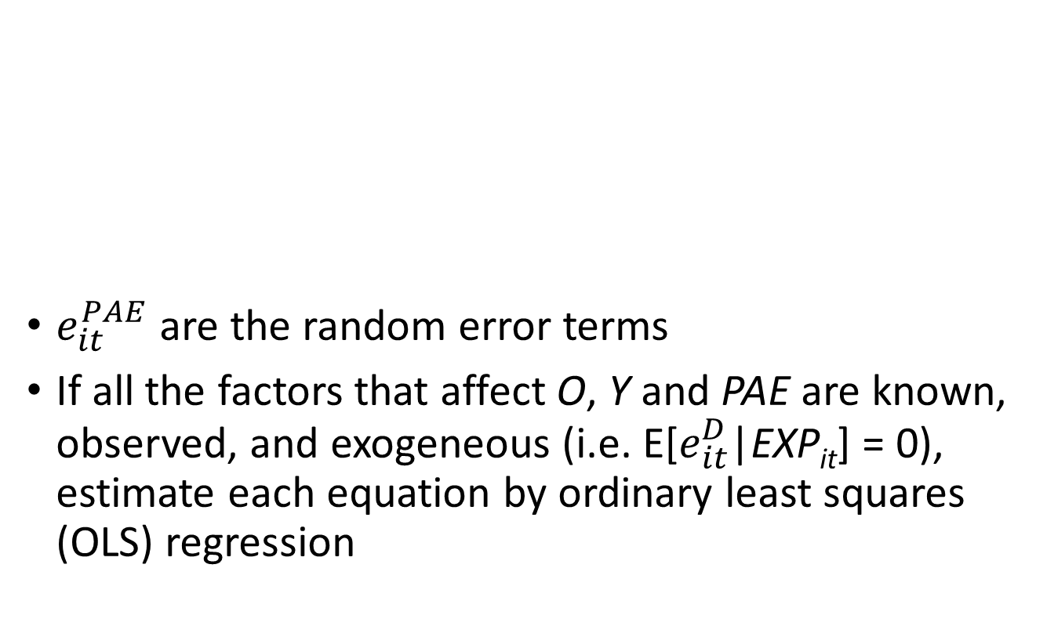
Models to be estimated (1)
$e_{it}^{PAE}$ are the random error terms
If all the factors that affect O, Y and PAE are known, observed, and exogeneous (i.e. E[$e_{it}^{D}$|EXP_{it}] = 0), estimate each equation by ordinary least squares (OLS) regression
$$O_{it}=f_{o}\left(X_{it}^{O},C_{it},Y_{it},{PAE}_{jt},{PAE}_{jt−l}\right)+e_{it}^{o}$$
…1
$$Y_{it}=f_{y}\left(X_{it}^{Y}, {PAE}_{jt},{PAE}_{jt−l}\right)+e_{it}^{Y}$$
…2
$${PAE}_{jt}=f_{p}\left(X_{it}^{PAE},{PAE}_{jt−l},C_{jt},O_{it}\right)+e_{jt}^{PAE}$$
…3
D = Dependent variables; EXP = explanatory variables

Slide 45
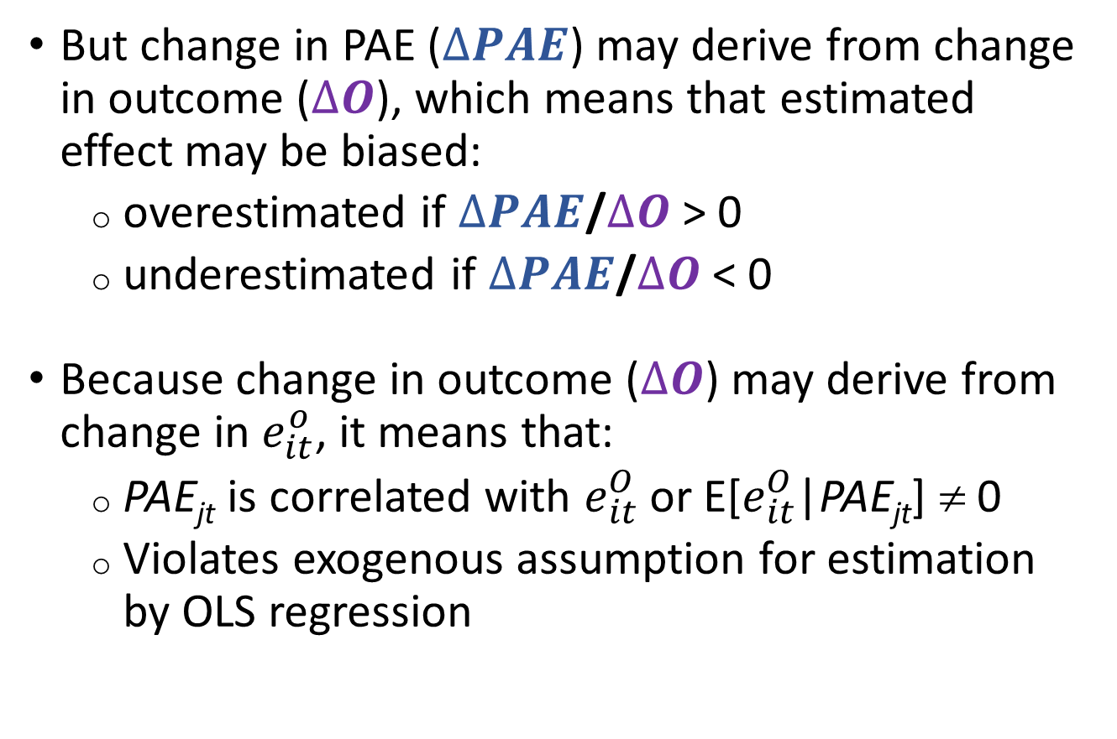
Models to be estimated (2)
But change in PAE ($∆PAE$) may derive from change in outcome ($∆O$), which means that estimated effect may be biased:
  overestimated if $∆PAE$/$∆O$ > 0
  underestimated if $∆PAE$/$∆O$ < 0
Because change in outcome ($∆O$) may derive from change in $e_{it}^{o}$, it means that:
  PAE_{jt} is correlated with $e_{it}^{O}$ or E[$e_{it}^{O}$|PAE_{jt}] ≠ 0
  Violates exogenous assumption for estimation by OLS regression

Slide 46
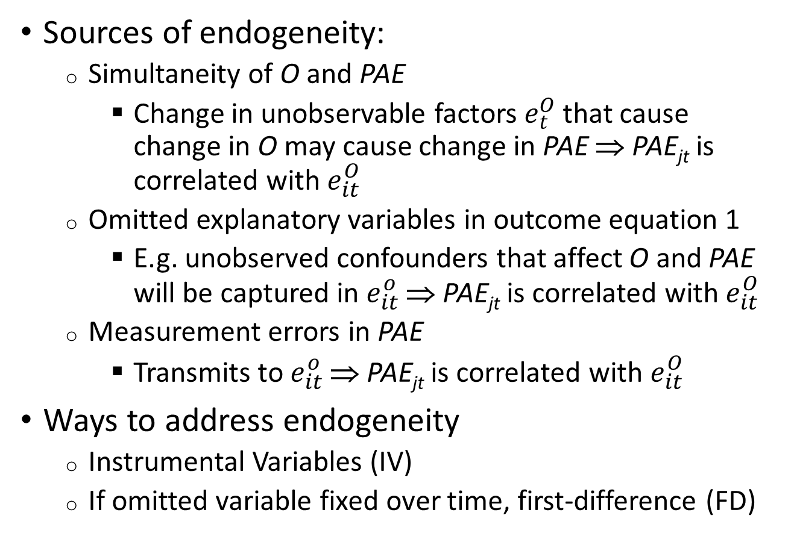
Sources of endogeneity and solutions
Sources of endogeneity:
  Simultaneity of O and PAE
    Change in unobservable factors $e_{t}^{O}$ that cause change in O may cause change in PAE ⇒ PAE_{jt} is correlated with $e_{it}^{O}$
  Omitted explanatory variables in outcome equation 1
    E.g. unobserved confounders that affect O and PAE will be captured in $e_{it}^{o}$ ⇒ PAE_{jt} is correlated with $e_{it}^{O}$
  Measurement errors in PAE
    Transmits to $e_{it}^{o}$ ⇒ PAE_{jt} is correlated with $e_{it}^{O}$
Ways to address endogeneity
  Instrumental Variables (IV)
  If omitted variable fixed over time, first-difference (FD)

Slide 47
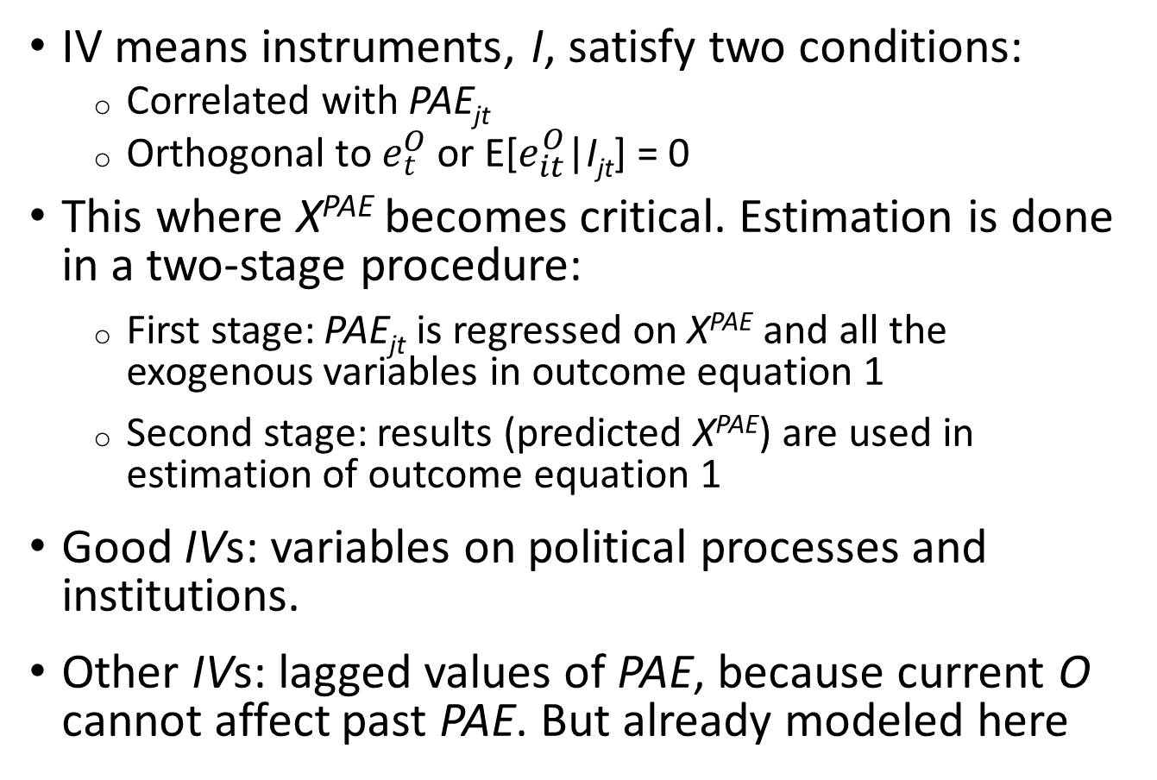
Instrumental Variables (IV)
IV means instruments, I, satisfy two conditions:
  Correlated with PAE_{jt}
  Orthogonal to $e_{t}^{O}$ or E[$e_{it}^{O}$|I_{jt}] = 0
This where X^{PAE} becomes critical. Estimation is done in a two-stage procedure:
  First stage: PAE_{jt} is regressed on X^{PAE} and all the exogenous variables in outcome equation 1
  Second stage: results (predicted X^{PAE}) are used in estimation of outcome equation 1
Good IVs: variables on political processes and institutions.
Other IVs: lagged values of PAE, because current O cannot affect past PAE. But already modeled here

Slide 48
First Difference (FD)
If source of endogeneity is due to unobserved omitted variable that is fixed over time (e.g. agro-climate), estimate by FD to remove endogeneity:
Caveat: FD may remove the long-term effect of PAE
$$O_{it}−O_{it−1}=f_{o}\left({EXP}_{it}^{O}−{EXP}_{it−1}^{O}\right)+e_{it}^{o}$$
…1’
$$Y_{it}−Y_{it−1}=f_{y}\left({EXP}_{it}^{Y}−{EXP}_{it−1}^{Y}\right)+e_{it}^{Y}$$
…2’
$${PAE}_{jt}−{PAE}_{jt−1}=f_{p}\left({EXP}_{it}^{PAE}−{EXP}_{it−1}^{PAE}\right)+e_{jt}^{PAE}$$
…3’
Simplified notation: EXP = explanatory variables

Slide 49
Other estimation issues
Optimal lag length may be determined at minimum Akaike Information Criterion (AIC) and maximum adjusted R-squared of model fit
With panel data (i.e., cross-section and time-series) issues with e_{t} may render estimates inconsistent:
  Serial correlation means that e_{t} and e_{t-1} or e_{t-n} are correlated
  Heteroskedasticity means the variance of e_{t} is not constant across the values of the explanatory variables
  These two lead to underestimation of the standard errors (overestimation of statistical significance)
  Correct by e.g. clustering the standard errors

Slide 50
Estimation (PAE is continuous)
Several statistical packages developed based on the different assumptions
  Overall model fit statistics
  Estimated parameters for explanatory variables, standard errors, statistical significance
  Diagnostic tests regarding underlying assumptions
STATA: simultaneous equations estimation
  Generalized structural equation model estimation (gsem, sem)
STATA: single (reduced-form) equation estimation
  Instrumental variables and two-stage least squares for panel-data models (xtivreg, xtivreg2)
STATA continuously being updated

Slide 51
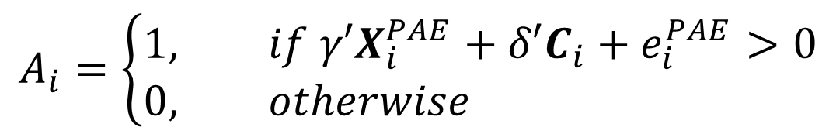
Estimation (PAE is a treatment)
As in program evaluation where some people obtained or exposed to intervention (treated, A_{i}=1) and others did not (untreated or control, A_{i}=0)
Same principles apply, except now (crudely written)
And A_{i} replaces PAE_{jt} and PAE_{jt-l} in the outcome and intermediate outcome equations (1 and 2)
Estimate treatment effects using Potential Outcome Approach (POA)
$$A_{i}=\left\{\begin{aligned}1, &if γ′X_{i}^{PAE}+{δ′C_{i}+e}_{i}^{PAE}>0 \\ 0, &otherwise\end{aligned}\right.$$
…3b

Slide 52

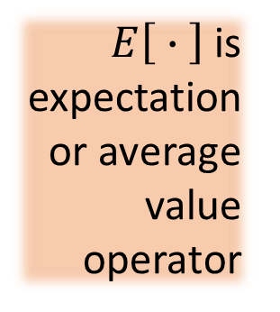
Potential Outcome Approach (1)
Hinges on a counterfactual or what outcome would have been observed for:
  Treated units had they not been treated $\left[O_{i}^{0} | A_{i}=1\right]$
  Untreated units had they been treated$\left[O_{i}^{1} | A_{i}=0\right]$
Outcome measured after treatment is $O_{0i}$ for untreated and $O_{1i}$ for treated
Average treatment effect (ATE)
Average treatment effect on the treated (ATT)
$E\left[ ∙ \right]$ is expectation or average value operator
$$ATE=E\left[O_{i}^{1} | A_{i}=0,1\right]−\left[O_{i}^{0} | A_{i}=0,1\right]$$
$$ATT=E\left[O_{i}^{1} | A_{i}=1\right]−E\left[O_{i}^{0} | A_{i}=1\right]$$

Slide 53
Potential Outcome Approach (2)
Estimate ATE or ATT by controlling for C and X under conditional independence assumption (CIA)
  control for the factors that affect treatment and outcomes to make the potential outcomes independent of treatment status
  ATT requires weaker CIA as only need potential outcomes of treated observations
Model-based treatment effects model
  Regression adjustment (RA) and/or inverse probability weighting (IPW) to first separate effect of treatment
Matching-method treatment effects model
  Use propensity scores or other techniques to match treated observations with untreated observations

Slide 54
Potential Outcome Approach (3)
Key question is how well covariates are balanced by weighting or matching
In STATA several options based on different weighing and matching methods
  Overall model fit statistics
  Estimated parameters for explanatory variables, standard errors, statistical significance
  Diagnostic tests regarding balance of covariates (basically distribution before and after weighting/matching)
STATA commands: teffects ipwra; teffects psmatch; psmatch2; with various options

Slide 55
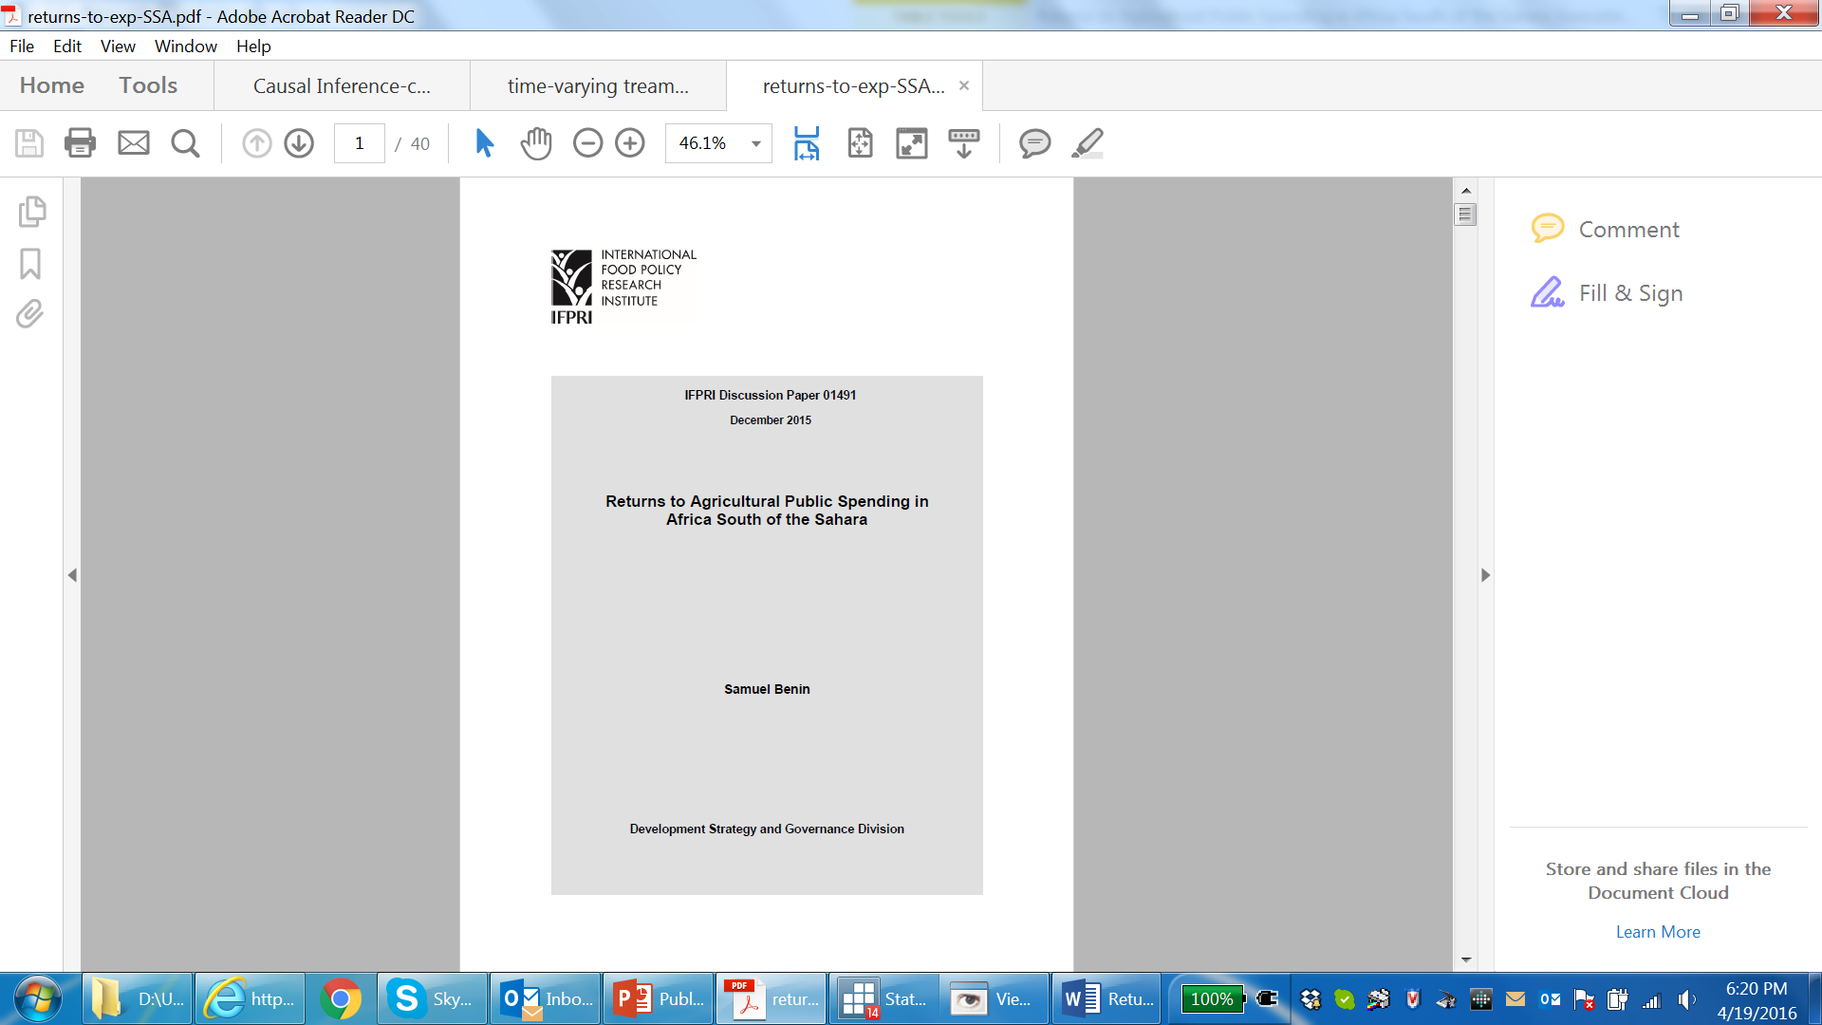

Example of estimations
Returns to PAE in SSA (xtivreg2)
Returns to investments and subsidies in India (sem)
Impact of extension in Uganda (psmatch2)
Impact of CAADP on outcomes (ipwra)

Slide 56
Returns to PAE in SSA (xtivreg2, sem)
Panel data on 34 SSA countries from 1980 to 2012
Outcome in agricultural land productivity
2 PAE measures: total agriculture, agricultural research
Several production and other variables
Instruments: governance indicators and regime characteristics and change
Twist to conventional POA: time-varying treatment and outcomes

Slide 57
Returns to PAE—select first-stage IV
Explanatory variable | Agricultural expenditure, US$/ha (gt) |  |  |  |  | Agricultural research expenditure, US$/ha (gr)
 | Model 1 |  | Model 2 |  |  | Model 1 |  | Model 2 |  | Model 3 |  | Model 4
Lags of ag expenditure
gt_{t-1} | 0.58 | *** | 0.57 | *** |  |  |  | 0.10 | *** |  |  | 0.08 | **
gt_{t-2} | 0.01 |  | 0.01
gt_{t-3} | -0.06 |  | -0.06
gt_{t-4} | 0.04 |  | 0.04
gt_{t-5} | -0.07 | * | -0.07 | *
Total elasticity‡ | 0.49 | *** | 0.49 | ***
Ag research capital |  |  |  |  |  | 0.52 | *** | 0.49 | *** | 0.54 | *** | 0.52 | ***
Instruments (Z^{G})
Stability | 0.15 | *** | 0.15 | ***
Polity |  |  |  |  |  | 0.03 | *** | 0.03 | *** | 0.03 | *** | 0.03 | ***
Overall model statistics
R-squared | 0.74 |  | 0.74 |  |  | 0.20 |  | 0.22 |  | 0.26 |  | 0.27
F-statistic | 82.21 | *** | 77.57 | *** |  | 5.99 | *** | 6.28 | *** | 7.98 | *** | 7.84 | ***
IV tests:
Exp is exogenous (χ² stat) | 2.22 |  | 0.28 |  |  | 0.00 |  | 0.02 |  | 0.21 |  | 0.22
Underidentified (χ² stat) | 15.58 | *** | 15.58 | *** |  | 15.90 | *** | 16.94 | *** | 15.72 | *** | 16.51 | ***
Instrum is weak (F-stat) | 15.53 | *** | 16.39 | *** |  | 16.05 | *** | 17.10 | *** | 15.80 | *** | 16.59 | ***

Slide 58
Elasticities land productivity w.r.t:
 | Fixed-effects only |  |  |  | Fixed effects, IV
 | FE model 2 |  | FE model 2 |  | FE-IV model 2 |  | FE-IV model 2
Lags of Ag Exp
gt_{t} | -0.01 |  | 0.00 |  | 0.17 |  | 0.04
gt_{t-1} | -0.01 |  | 0.01 |  | -0.11 |  | -0.02
gt_{t-2} | 0.03 |  | 0.02 |  | 0.03 |  | 0.02
gt_{t-3} | -0.03 |  | -0.03 | * | -0.02 |  | -0.03
gt_{t-4} | 0.00 |  | 0.01 |  | -0.01 |  | 0.00
gt_{t-5} | 0.07 | *** | 0.04 | *** | 0.08 | *** | 0.04 | ***
Total elasticity‡ | 0.04 | ** | 0.04 | ** | 0.13 | ** | 0.06
 | FE model 1 |  | FE model 2 |  | FE model 3 |  | FE model 3
Ag research exp | -0.06 | *** | -0.06 | ** | 0.02 |  | 0.02
Ag research capital | 0.14 | *** | 0.15 | *** | 0.08 | ** | 0.08 | **
Total elasticity‡ | 0.08 | ** | 0.09 | ** | 0.09 | *** | 0.09 | ***

Slide 59
Returns to investments in India (1)
 | Return in agricultural GDP (RPS per RPS spending)
 | 1960s–1970s |  |  | 1980s |  |  | 1990s
 | Return | R1 | R2 | Return | R1 | R2 | Return | R1 | R2
Agricultural sector
Research & dev’t | 8.65 | 2 | 5 | 7.93 | 1 | 2 | 9.50 | 1 | 1
Irrigation investment | 8.00 | 3 | 6 | 4.71 | 2 | 4 | 4.37 | 2 | 4
Irrigation subsidies | 5.22 | 4 | 7 | 2.25 | 4 | 6 | 2.47 | 4 | 6
Fertilizer subsidies | 1.79 | 5 | 8 | 1.94 | 5 | 8 | 0.85 | 5 | 8
Credit subsidies | 18.77 | 1 | 2 | 3.00 | 3 | 5 | 4.26 | 3 | 5
Rural sector
Roads | 19.99 | 1 | 1 | 8.89 | 1 | 1 | 7.66 | 1 | 2
Education | 14.66 | 2 | 3 | 7.58 | 2 | 3 | 5.46 | 2 | 3
Power subsidies | 12.06 | 3 | 4 | 2.25 | 3 | 6 | 1.19 | 3 | 7
Source: Based on Fan, Gulati, and Thorat (2008).
RPS = Retention Pricing Scheme. R1 = rank of return within sector, where 1 is the highest rank. R2 = rank of return across sectors, where 1 is the highest rank.

Slide 60
Returns to investments in India (2)
 | Number of poor reduced per million RPS spending
 | 1960s–1970s |  |  | 1980s |  |  | 1990s
 | Return | R1 | R2 | Return | R1 | R2 | Return | R1 | R2
Agricultural sector
Research & dev’t | 642.69 | 2 | 5 | 409.00 | 1 | 3 | 436.12 | 1 | 2
Irrigation investment | 630.37 | 3 | 6 | 267.01 | 2 | 4 | 193.21 | 3 | 5
Irrigation subsidies | 393.70 | 4 | 7 | 116.05 | 4 | 7 | 113.47 | 4 | 6
Fertilizer subsidies | 90.07 | 5 | 8 | 109.99 | 5 | 8 | 37.41 | 5 | 8
Credit subsidies | 1448.51 | 1 | 3 | 154.59 | 3 | 5 | 195.66 | 2 | 4
Rural sector
Roads | 4124.15 | 1 | 1 | 1311.64 | 1 | 1 | 881.49 | 1 | 1
Education | 1955.56 | 2 | 2 | 651.40 | 2 | 2 | 335.86 | 2 | 3
Power subsidies | 998.42 | 3 | 4 | 125.50 | 3 | 6 | 59.15 | 3 | 7
Source: Based on Fan, Gulati, and Thorat (2008).
RPS = Retention Pricing Scheme. R1 = rank of return within sector, where 1 is the highest rank. R2 = rank of return across sectors, where 1 is the highest rank.

Slide 61
Impact of extension in Uganda (psmatch2)
Household (HH) surveys in 2004 and 2007 (719 panel HHs). Categorized NAADS into three cohorts based on year NAADS program introduced into sub-county. Impact on Income.
Cohort (sub-county) | Year introduced | Sample size (HHs)
 |  | 2004 | 2007 | Panel
Early NAADS | 2001/02 | 402 | 402 | 323
Intermediate NAADS | 2002/03 | 300 | 300 | 202
Late NAADS | 2005/06 | 81 | 81 | 81
Non-NAADS | n.a. | 119 | 417 | 113
Total |  | 902 | 1200 | 719

Slide 62
Measurement of treatment (NAADS_{j})
 | Number of Observations
Treatment (NAADS_{j} = 1): households who are members of a NAADS-participating farmer group | 66
Comparison or control (NAADS_{j} = 0):
Those in the same area where the program is implemented and claimed to have benefited indirectly from the program (NAADS_{NON-1}) | 250
Those in the same area where the program is implemented but did not claim any benefits (NAADS_{NON-2}) | 288
Those in the areas where the program was never implemented (NAADS_{NON-3}) | 115

Slide 63
Sample characteristics between treatment and comparison groups
(selected variables, matching with nearest 3 neighbors)
Variable | Sample | Treated |  | NAADS_{NON-1} |  | NAADS_{NON-2} |  | NAADS_{NON-3}
Gender of head | Unmatched | 0.21 |  | 0.13 | ** | 0.16 |  | 0.24
 | Matched | 0.24 |  | 0.21 |  | 0.28 |  | 0.17
Age of head | Unmatched | 42.83 |  | 45.36 | ** | 43.23 |  | 42.80
 | Matched | 43.62 |  | 41.61 |  | 43.93 |  | 43.45
Primary education | Unmatched | 0.64 |  | 0.55 | ** | 0.66 |  | 0.61
 | Matched | 0.62 |  | 0.69 |  | 0.59 |  | 0.54
Post prim education | Unmatched | 0.21 |  | 0.35 | *** | 0.18 |  | 0.22
 | Matched | 0.21 |  | 0.16 |  | 0.24 |  | 0.30
Household size | Unmatched | 4.57 |  | 5.42 | *** | 4.92 | * | 5.21 | **
 | Matched | 4.63 |  | 4.90 |  | 4.28 |  | 5.06
Other organization | Unmatched | 0.38 |  | 0.84 | *** | 0.44 |  | 0.44
 | Matched | 0.44 |  | 0.79 | *** | 0.40 |  | 0.42
Land owned | Unmatched | 1.24 |  | 3.31 |  | 2.61 | * | 1.82
 | Matched | 0.97 |  | 2.81 |  | 1.09 |  | 0.91
Agricultural income | Unmatched | 193.14 |  | 320.37 | *** | 222.86 |  | 203.38
 | Matched | 233.81 |  | 359.50 | ** | 218.16 |  | 304.77
Distance to credit | Unmatched | 18.73 |  | 19.88 |  | 16.78 |  | 28.34 | ***
 | Matched | 17.45 |  | 18.32 |  | 15.12 |  | 15.69
Distance to market | Unmatched | 6.92 |  | 9.35 | *** | 7.67 |  | 9.24 | **
 | Matched | 6.73 |  | 7.41 |  | 6.35 |  | 7.21
Number of obs. |  |  |  | 118.00 |  | 111.00 |  | 70.00

Slide 64
Estimated treatment effects (%), selected results
 | NAADS_{NON-1} |  | NAADS_{NON-2} |  | NAADS_{NON-3}
Without covariates
1 nearest neighbor | 18.3 |  | 46.4 | * | 111.0 | **
3 nearest neighbors | 8.0 |  | 52.5 | * | 66.4 | *
5 nearest neighbors | 26.5 |  | 52.3 | * | 72.2 | **
With covariates, including potential endogenous variables
1 nearest neighbor | 1.6 |  | 12.2 |  | 25.4
3 nearest neighbors | 8.1 |  | 47.7 | * | 39.7
5 nearest neighbors | 26.6 |  | 43.9 | * | 44.3
With covariates, excluding potential endogenous variables
1 nearest neighbor | 24.6 |  | 22.6 |  | 59.0 | *
3 nearest neighbors | 22.0 |  | 59.6 | ** | 52.4 | *
5 nearest neighbors | 35.9 |  | 53.9 | ** | 61.1 | *

Slide 65
Impact of CAADP (ipwra) (1)
46 countries
Treatment at 3 periods: singing CAADP compact in 2007-09 or 2010-12 or 2013-14 or not at all
Outcomes and other variables measured at 2002-04 (base) and 3 above
7 indicators (expenditure, productivity, growth, income, nutrition)
5 conceptual determinants of treatment:
  Pretreatment outcomes, importance of agriculture, political will, peer pressure, and demand and capacity of citizens
Twist to conventional POA: time-varying treatment and outcomes

Slide 66
Impact of CAADP (2)—treatment
 | 2007-09 |  |  |  | 2010-12 |  |  |  | 2013-14
Explan. variable | Model 1 |  | Model 2 |  | Model 1 |  | Model 2 |  | Model 1 |  | Model 2
Ag area share | 0.10 | *** |  |  | 0.02 |  |  |  | 0.32 | ** | 0.36 | ***
Ag GDP share^{d} |  |  | 8.29 | *** |  |  | -0.03
AU charters | 0.79 | *** | 0.69 | * | 0.13 |  | 0.11 |  | 0.90 | *** | 1.00 | ***
Income status | -0.00 |  | 3.56 | * | -3.83 | *** | -4.32 | ** | -1.57
Voice | -0.97 |  | 1.10 |  | 0.44 |  | 0.57 |  | -19.4 | *** | -21.7 | ***
Intercept | -22.6 | *** | -23.0 | ** | -1.00 |  | 0.78 |  | -23.7 | ** | -28.0 | ***
Wald chi-squared | 10.2 | ** | 22.2 | *** | 19.2 | *** | 10.4 | ** | 23.6 | *** | 20.0 | ***
Pseudo R-squared | 0.61 |  | 0.70 |  | 0.49 |  | 0.49 |  | 0.72 |  | 0.71
Covariate balance test | 4.66 |  | 5.65 |  | 4.67 |  | 4.66 |  | 0.34 |  | 0.33
*, **, and *** indicate statistical significance at the 10 percent, 5 percent, and 1 percent levels, respectively

Slide 67
Impact of CAADP (3)—ATT
 | (t, s)=(1, 1) |  | (t, s)=(1, 2) |  | (t, s)=(1, 3) |  | (t, s)=(2, 2) |  | (t, s)=(2, 3) |  | (t, s)=(3, 3)
Agexpsh | 7.53 | ** | 2.94 | *** | -0.40 |  | 0.25 |  | -0.65 |  | 0.46
Agexpint | 10.47 | *** | 0.82 |  | -3.89 | ** | 7.44 |  | 3.42 |  | 18.0 | ***
Agvalnd | 3.28 | ** | 0.97 |  | 4.14 | *** | -6.61 |  | -5.56 | *** | 8.77 | **
Agvalab | 3.78 | ** | 2.67 | * | n.e. |  | -5.20 |  | n.e. |  | n.e.
Agvagr | 18.60 | * | 14.08 | *** | 16.15 | *** | -5.78 |  | -5.74 | *** | 7.09
Gdppc | 3.06 | *** | 1.84 | *** | 2.31 | *** | 0.15 |  | -0.30 |  | 5.19 | ***
Nourish | -4.96 | *** | -2.54 | *** | -1.11 | * | -0.96 |  | 3.31 | *** | -5.37 | ***
t = treatment period, s = measurement period
*, **, and *** indicate statistical significance at the 10 percent, 5 percent, and 1 percent levels, respectively

Slide 68

Key policy question
What types of public spending should be prioritized to raise the agricultural growth rate to 6% per year?
How much will it cost?
Chapter 3: Estimating public agricultural spending requirements (Benin, Fan and Johnson, 2012)

Slide 69
Economy-wide framework (I)
Economic growth
Household incomes and poverty
Agriculture
Industry
Rural
Linkages
Production
Domestic markets
for goods and services
Consumption
Linkages
Services
Indirect
taxes
Exports and imports
Urban
Foreign markets and countries
Public recurrent spending
Foreign
aid/loans
Government
Direct taxes
Sector policies
Household policies
Productivity (technology)
Public capital spending and macroeconomic policies
Foreign direct investments
Investment (capital)
Savings
Private investment

Slide 70
Economy-wide framework (II)
Economy-wide (production-side and demand-side)
Macro-micro linkages (growth ↔ employment ↔ incomes ↔ demand ↔ growth)
Sectoral detail (social accounting matrix, SAM)
Regional disaggregation (spatial differences)
Households (based on farm/non-farm incomes)
Can be used to analyze different growth paths and their effects on household incomes and poverty
Cannot tell us how to actually accelerate growth

Slide 71
Costing and prioritization
Based on:
  Modeling of different growth paths
  Effect of different types of public capital in the different growth paths
  Marginal cost of the different types of public capital
Estimate cost of different types of public investment in:
  Increasing agricultural growth by 1%
  Lifting one person or household out of poverty
Analyze:
  How outcomes vary across sub-national regions
  How different types of farmers may be affected
  Impact on rural employment and non-farm economy

Slide 72
The End
Thank You

